Slide 1


Slide 2
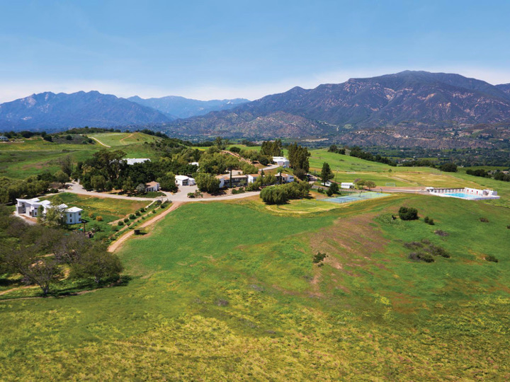


Slide 3
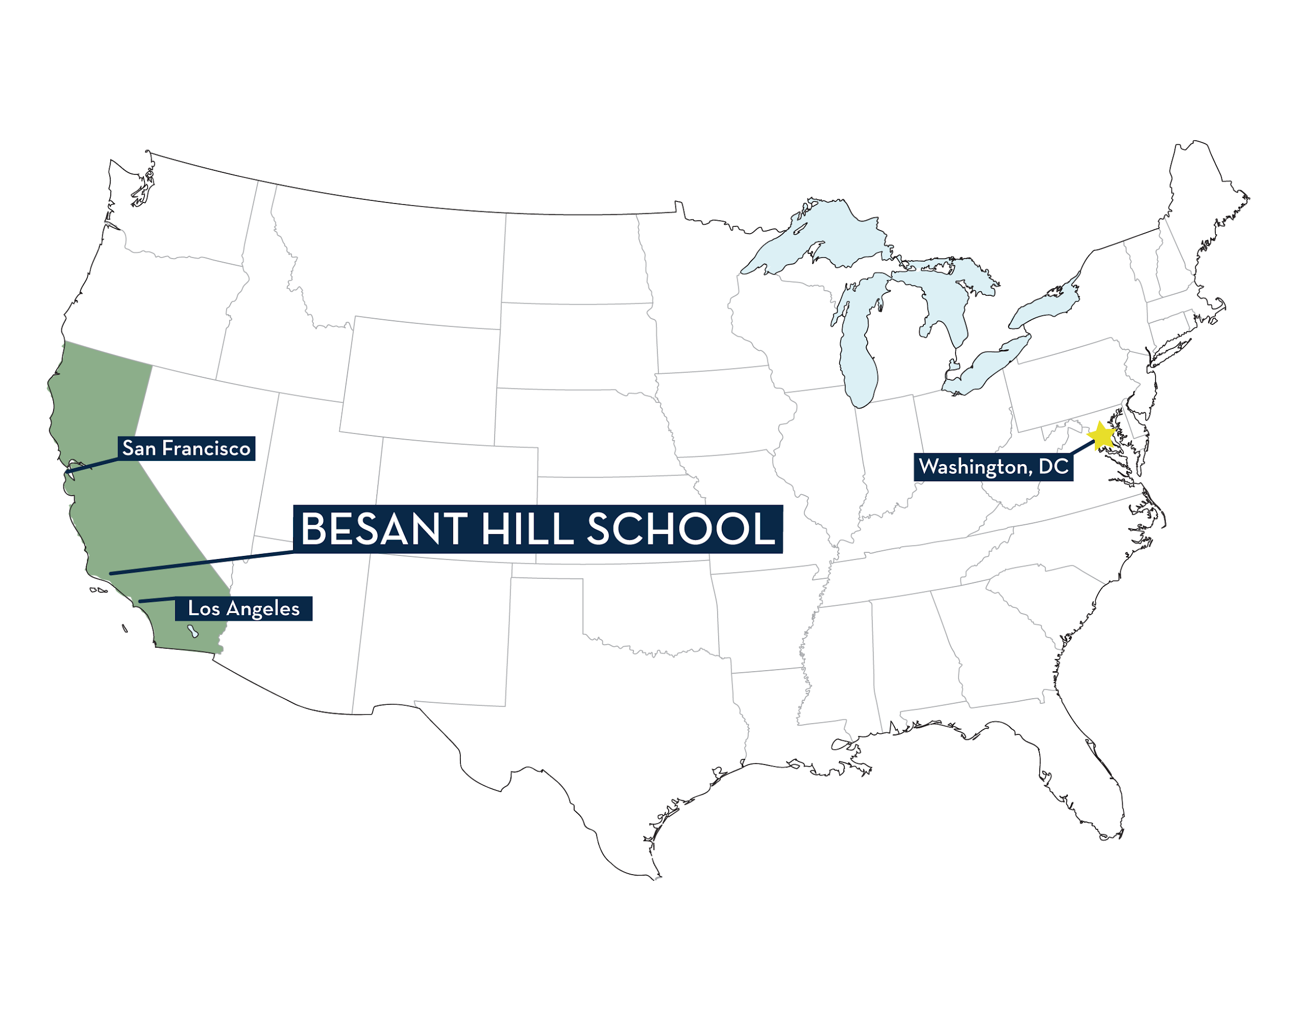
Notes:
ADD SCHOOL NAME AND LOGO TO AZ THROUGH TEXAS

Slide 4
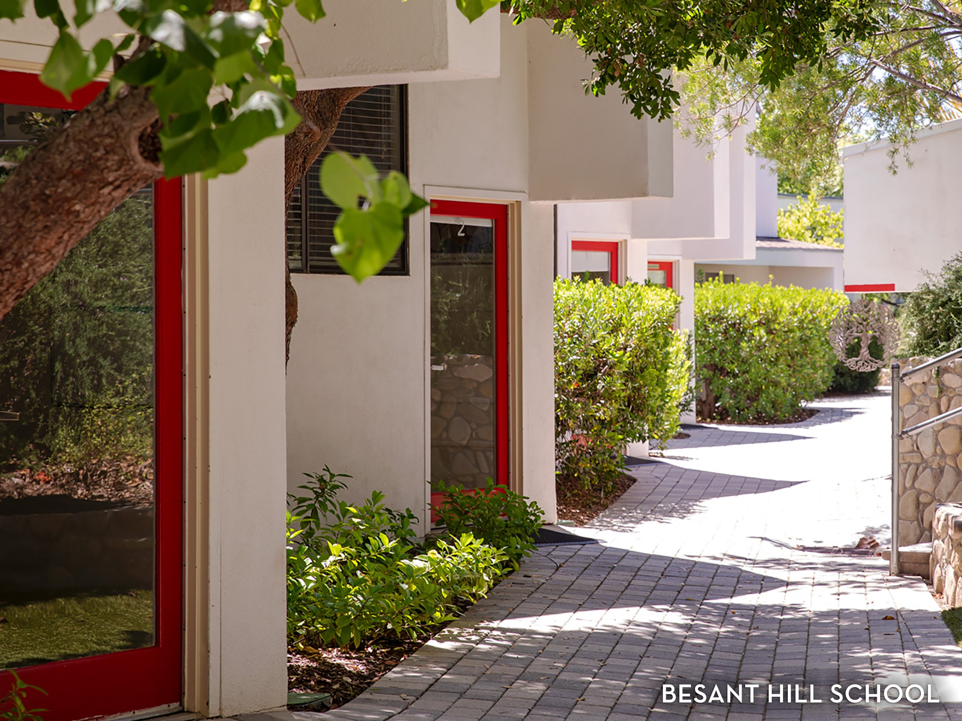

Slide 5
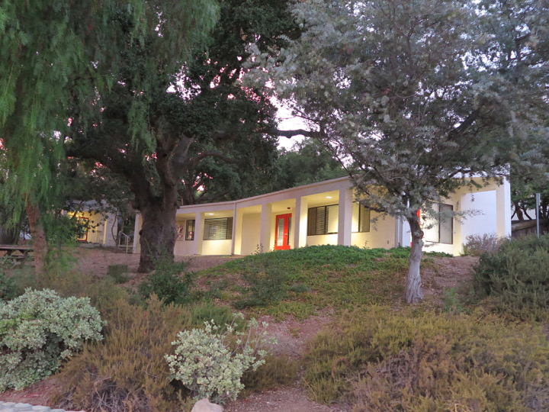
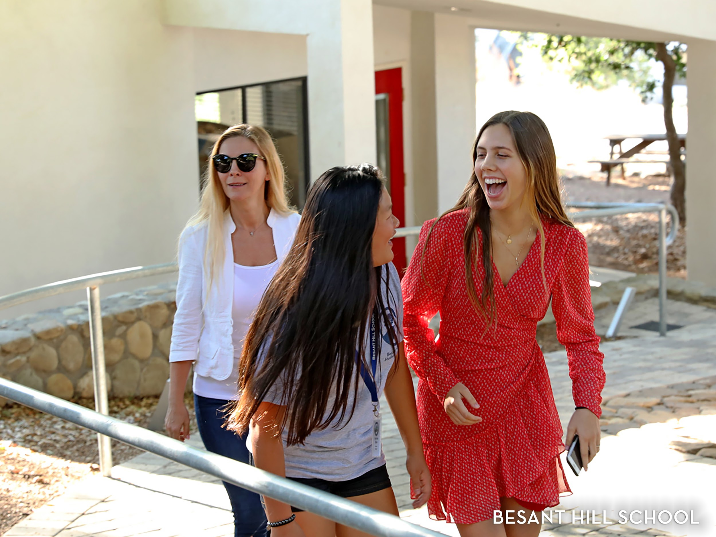

Slide 6
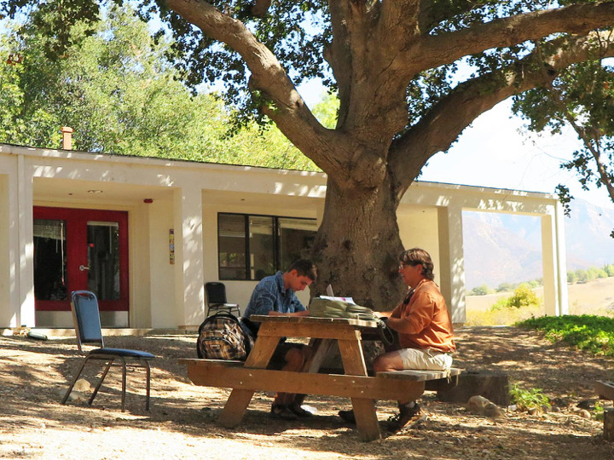
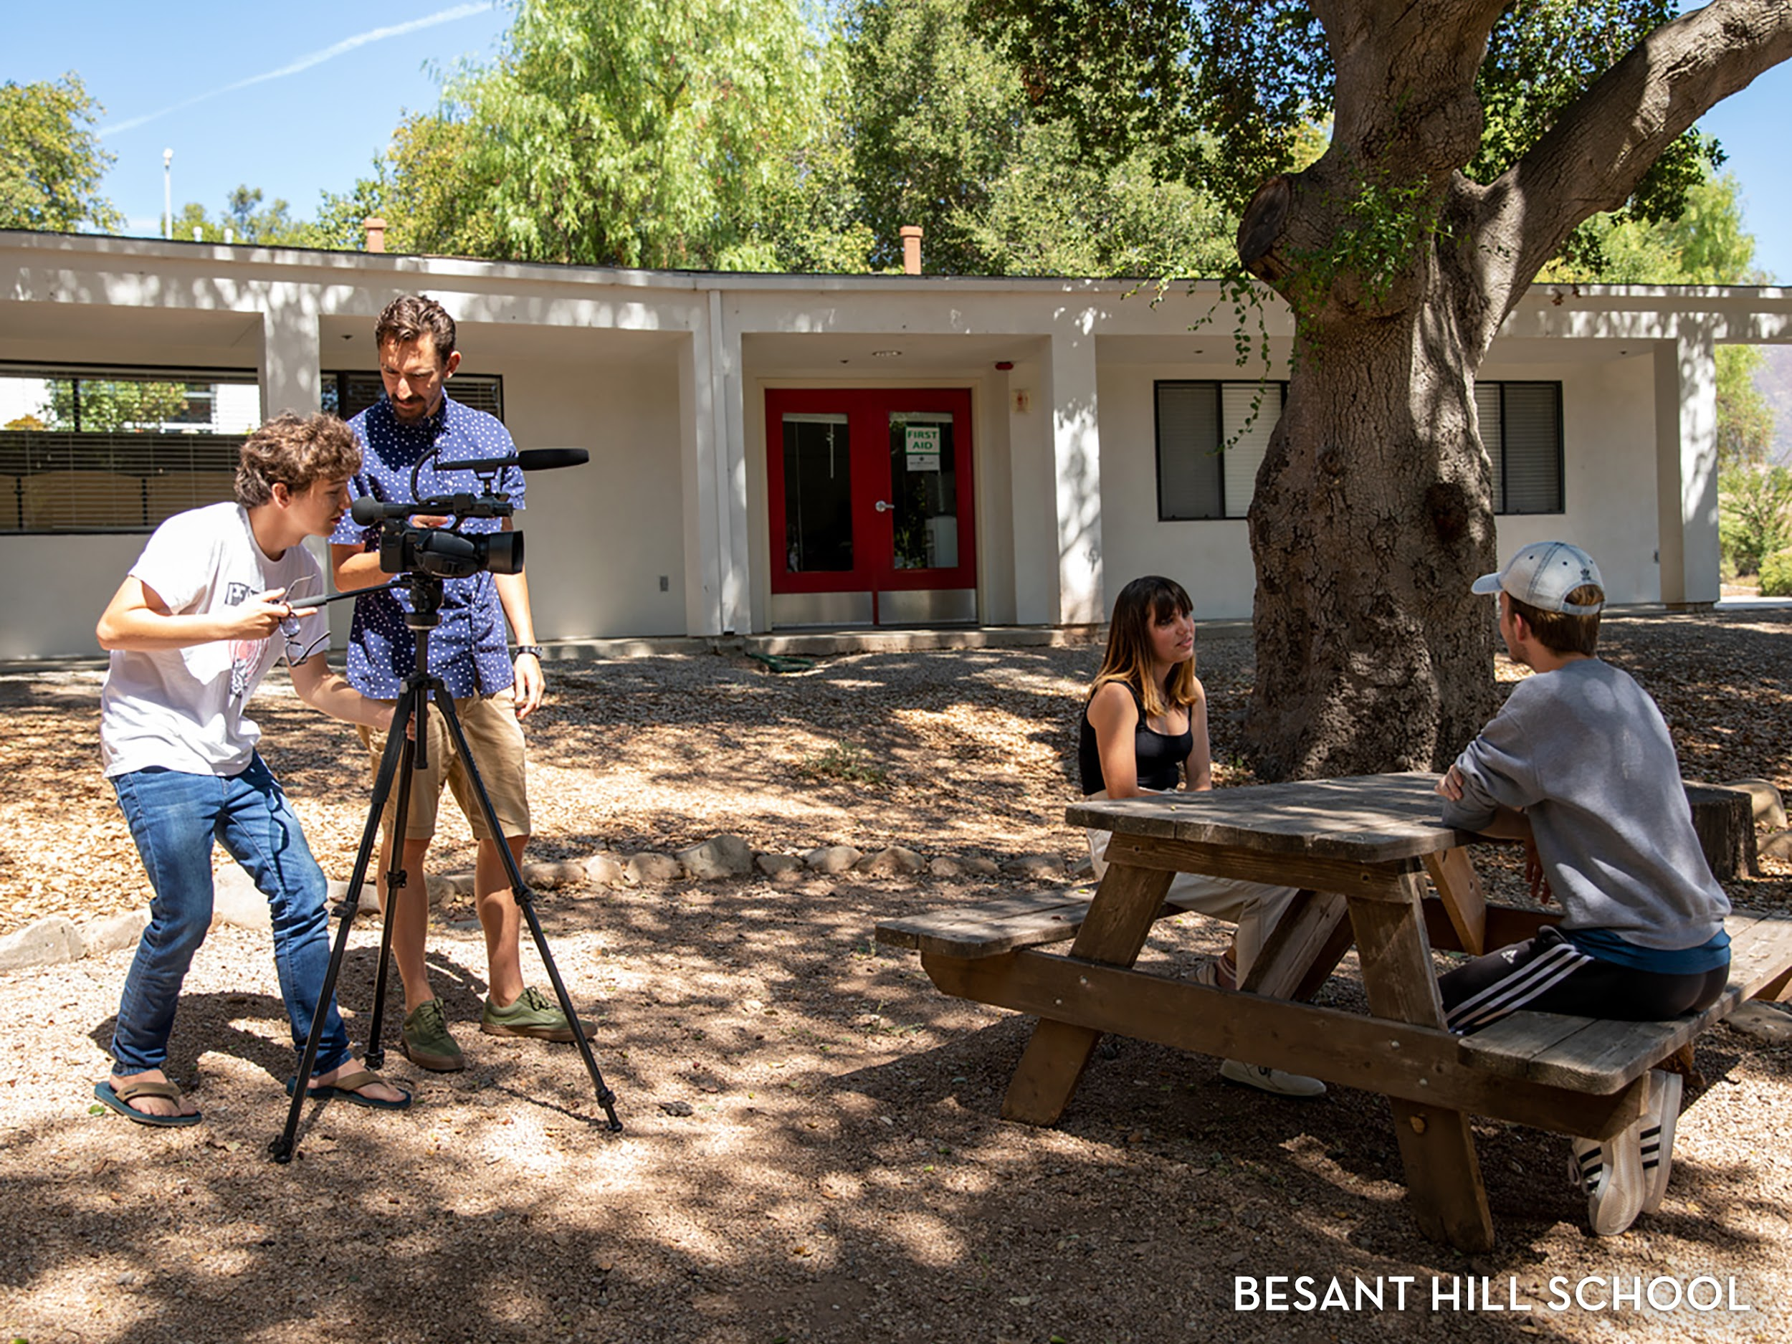

Slide 7
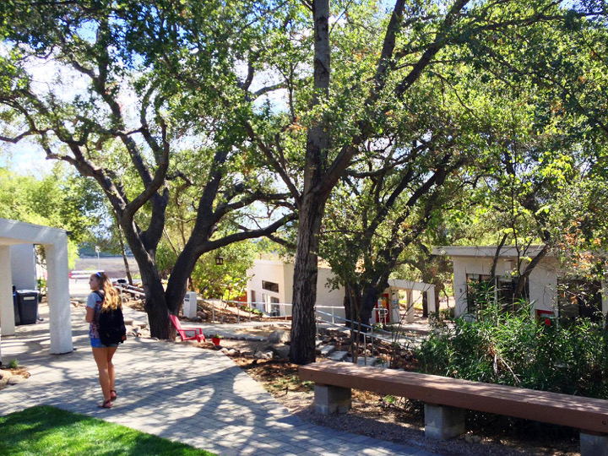
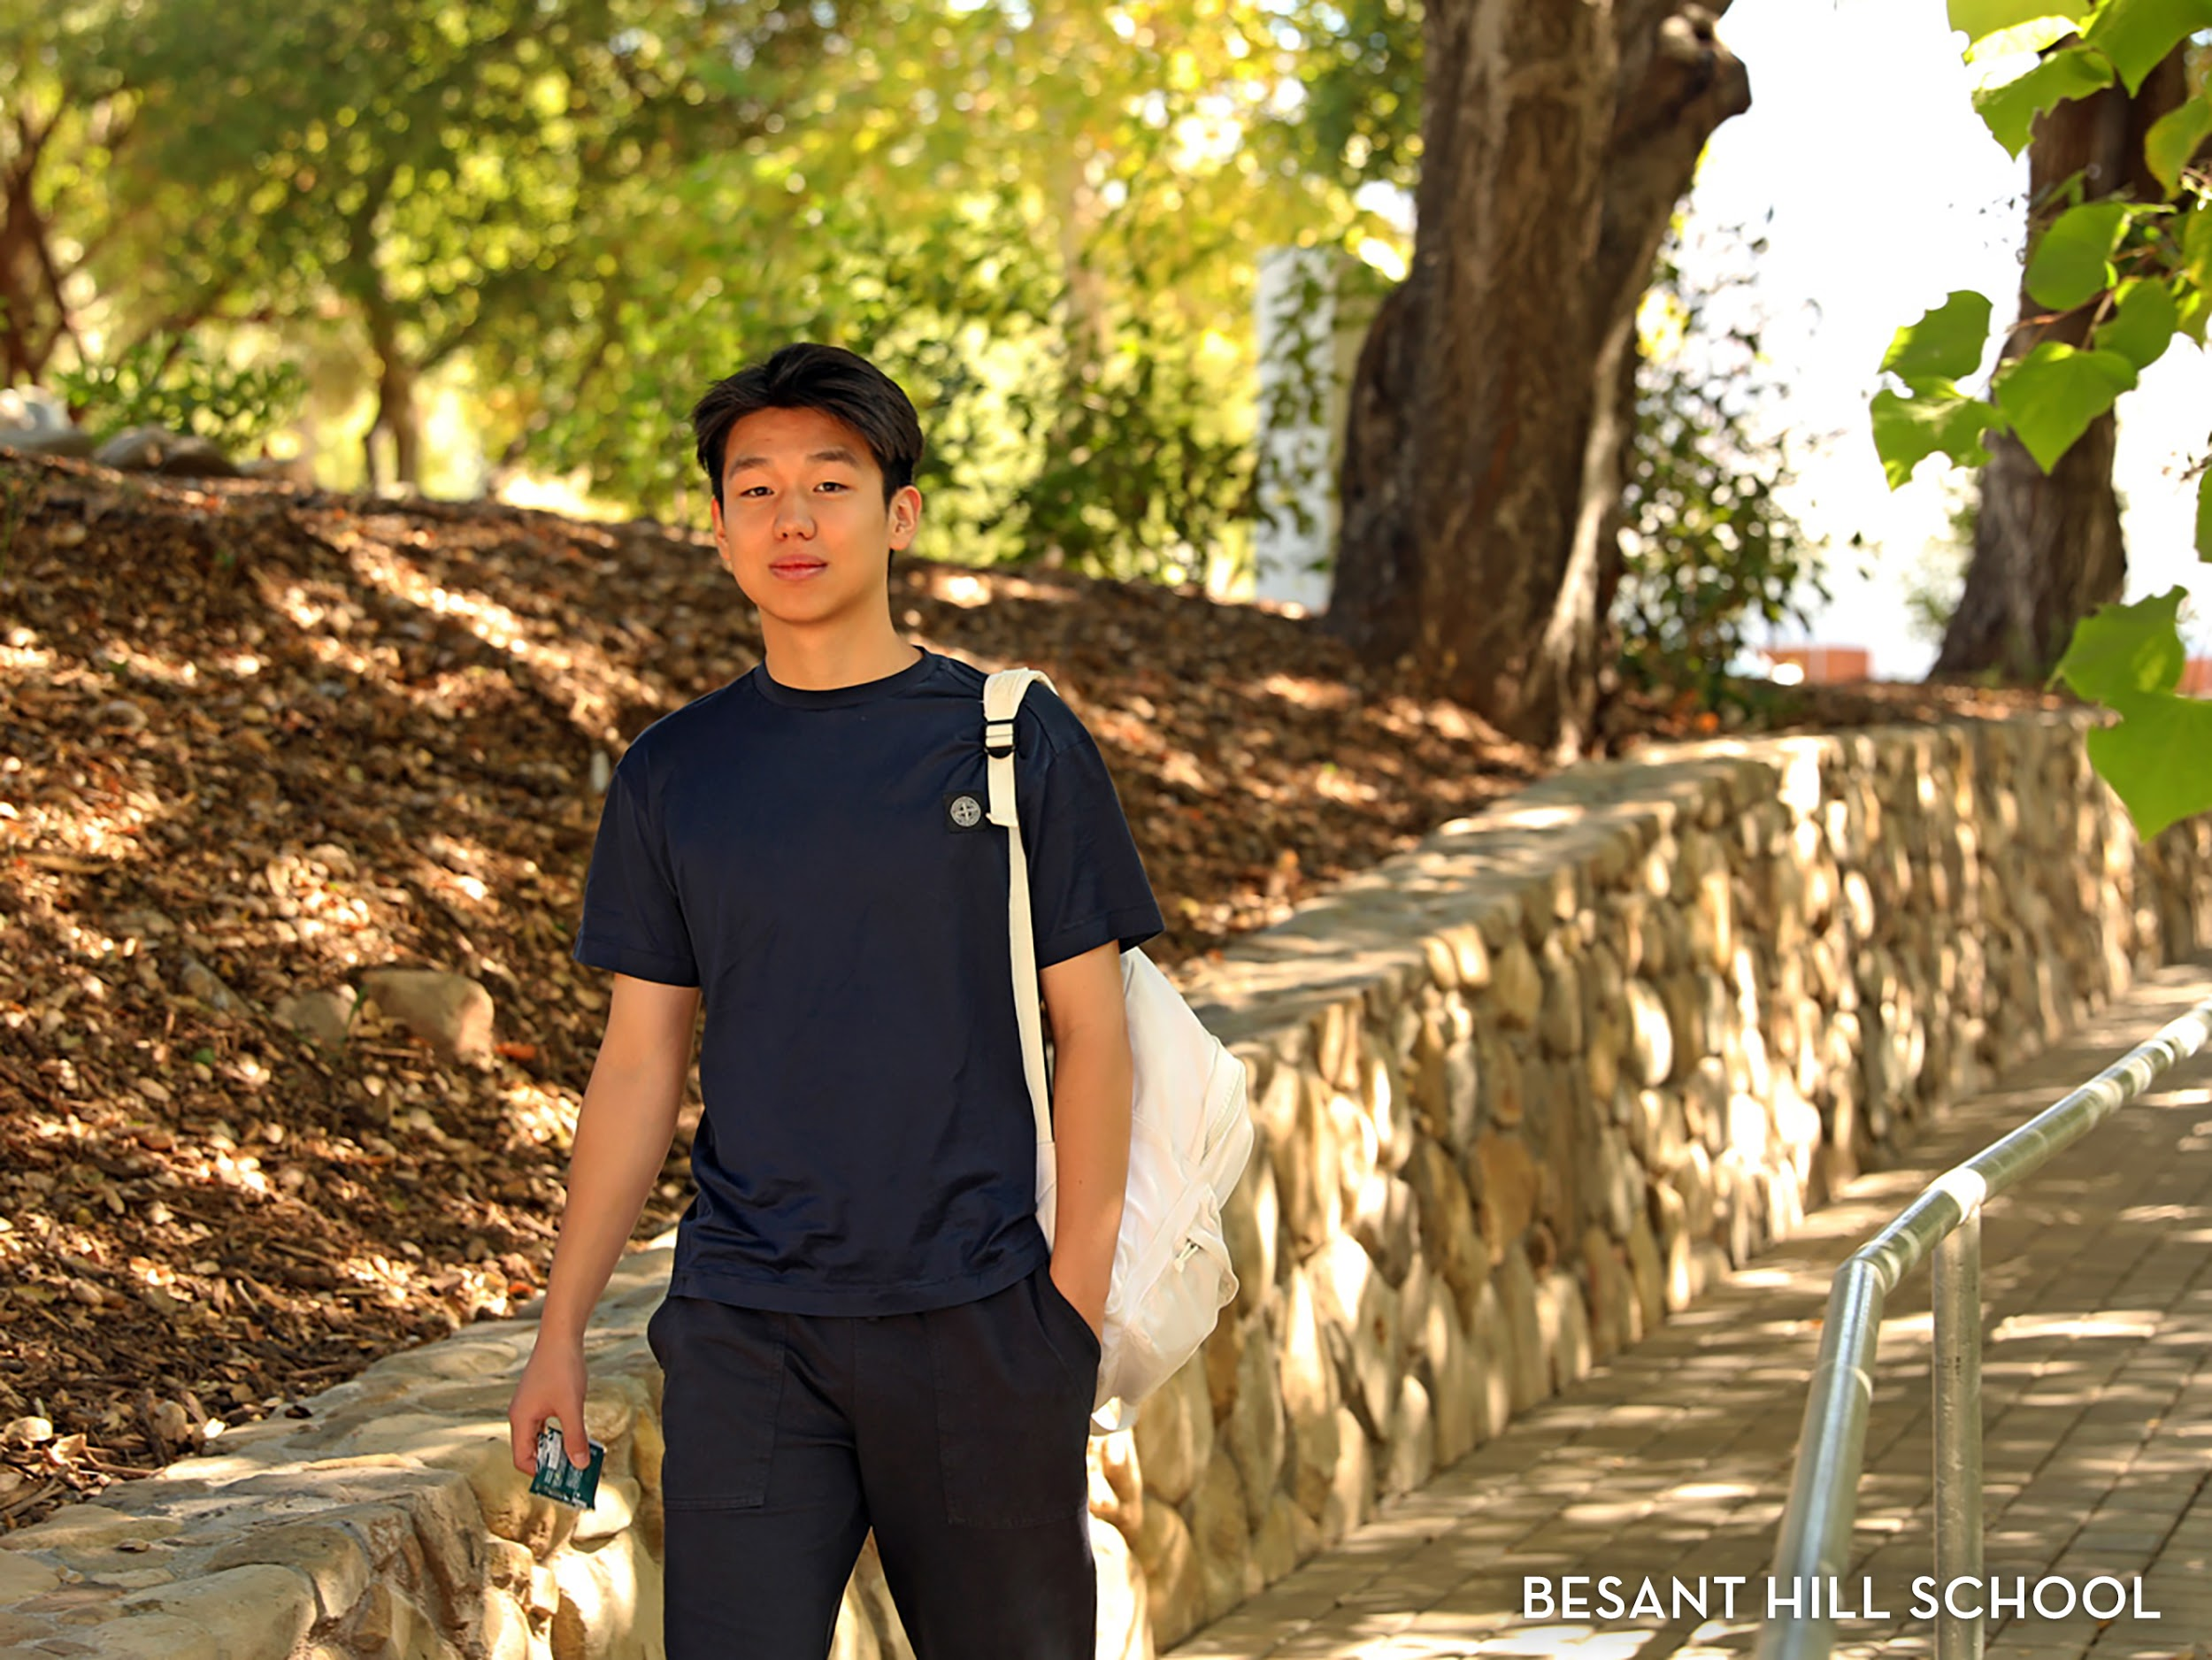

Slide 8

Notes:
We a traditional US high curriculum with AP level classes, SAT Prep and university placement. We offer all the sciences through the AP level. Given our location and land, our main strength is environmental science or sustainability. Those students interested in STEM related fields or environmental sciences, Besant Hill could be a wonderful option.

Slide 9
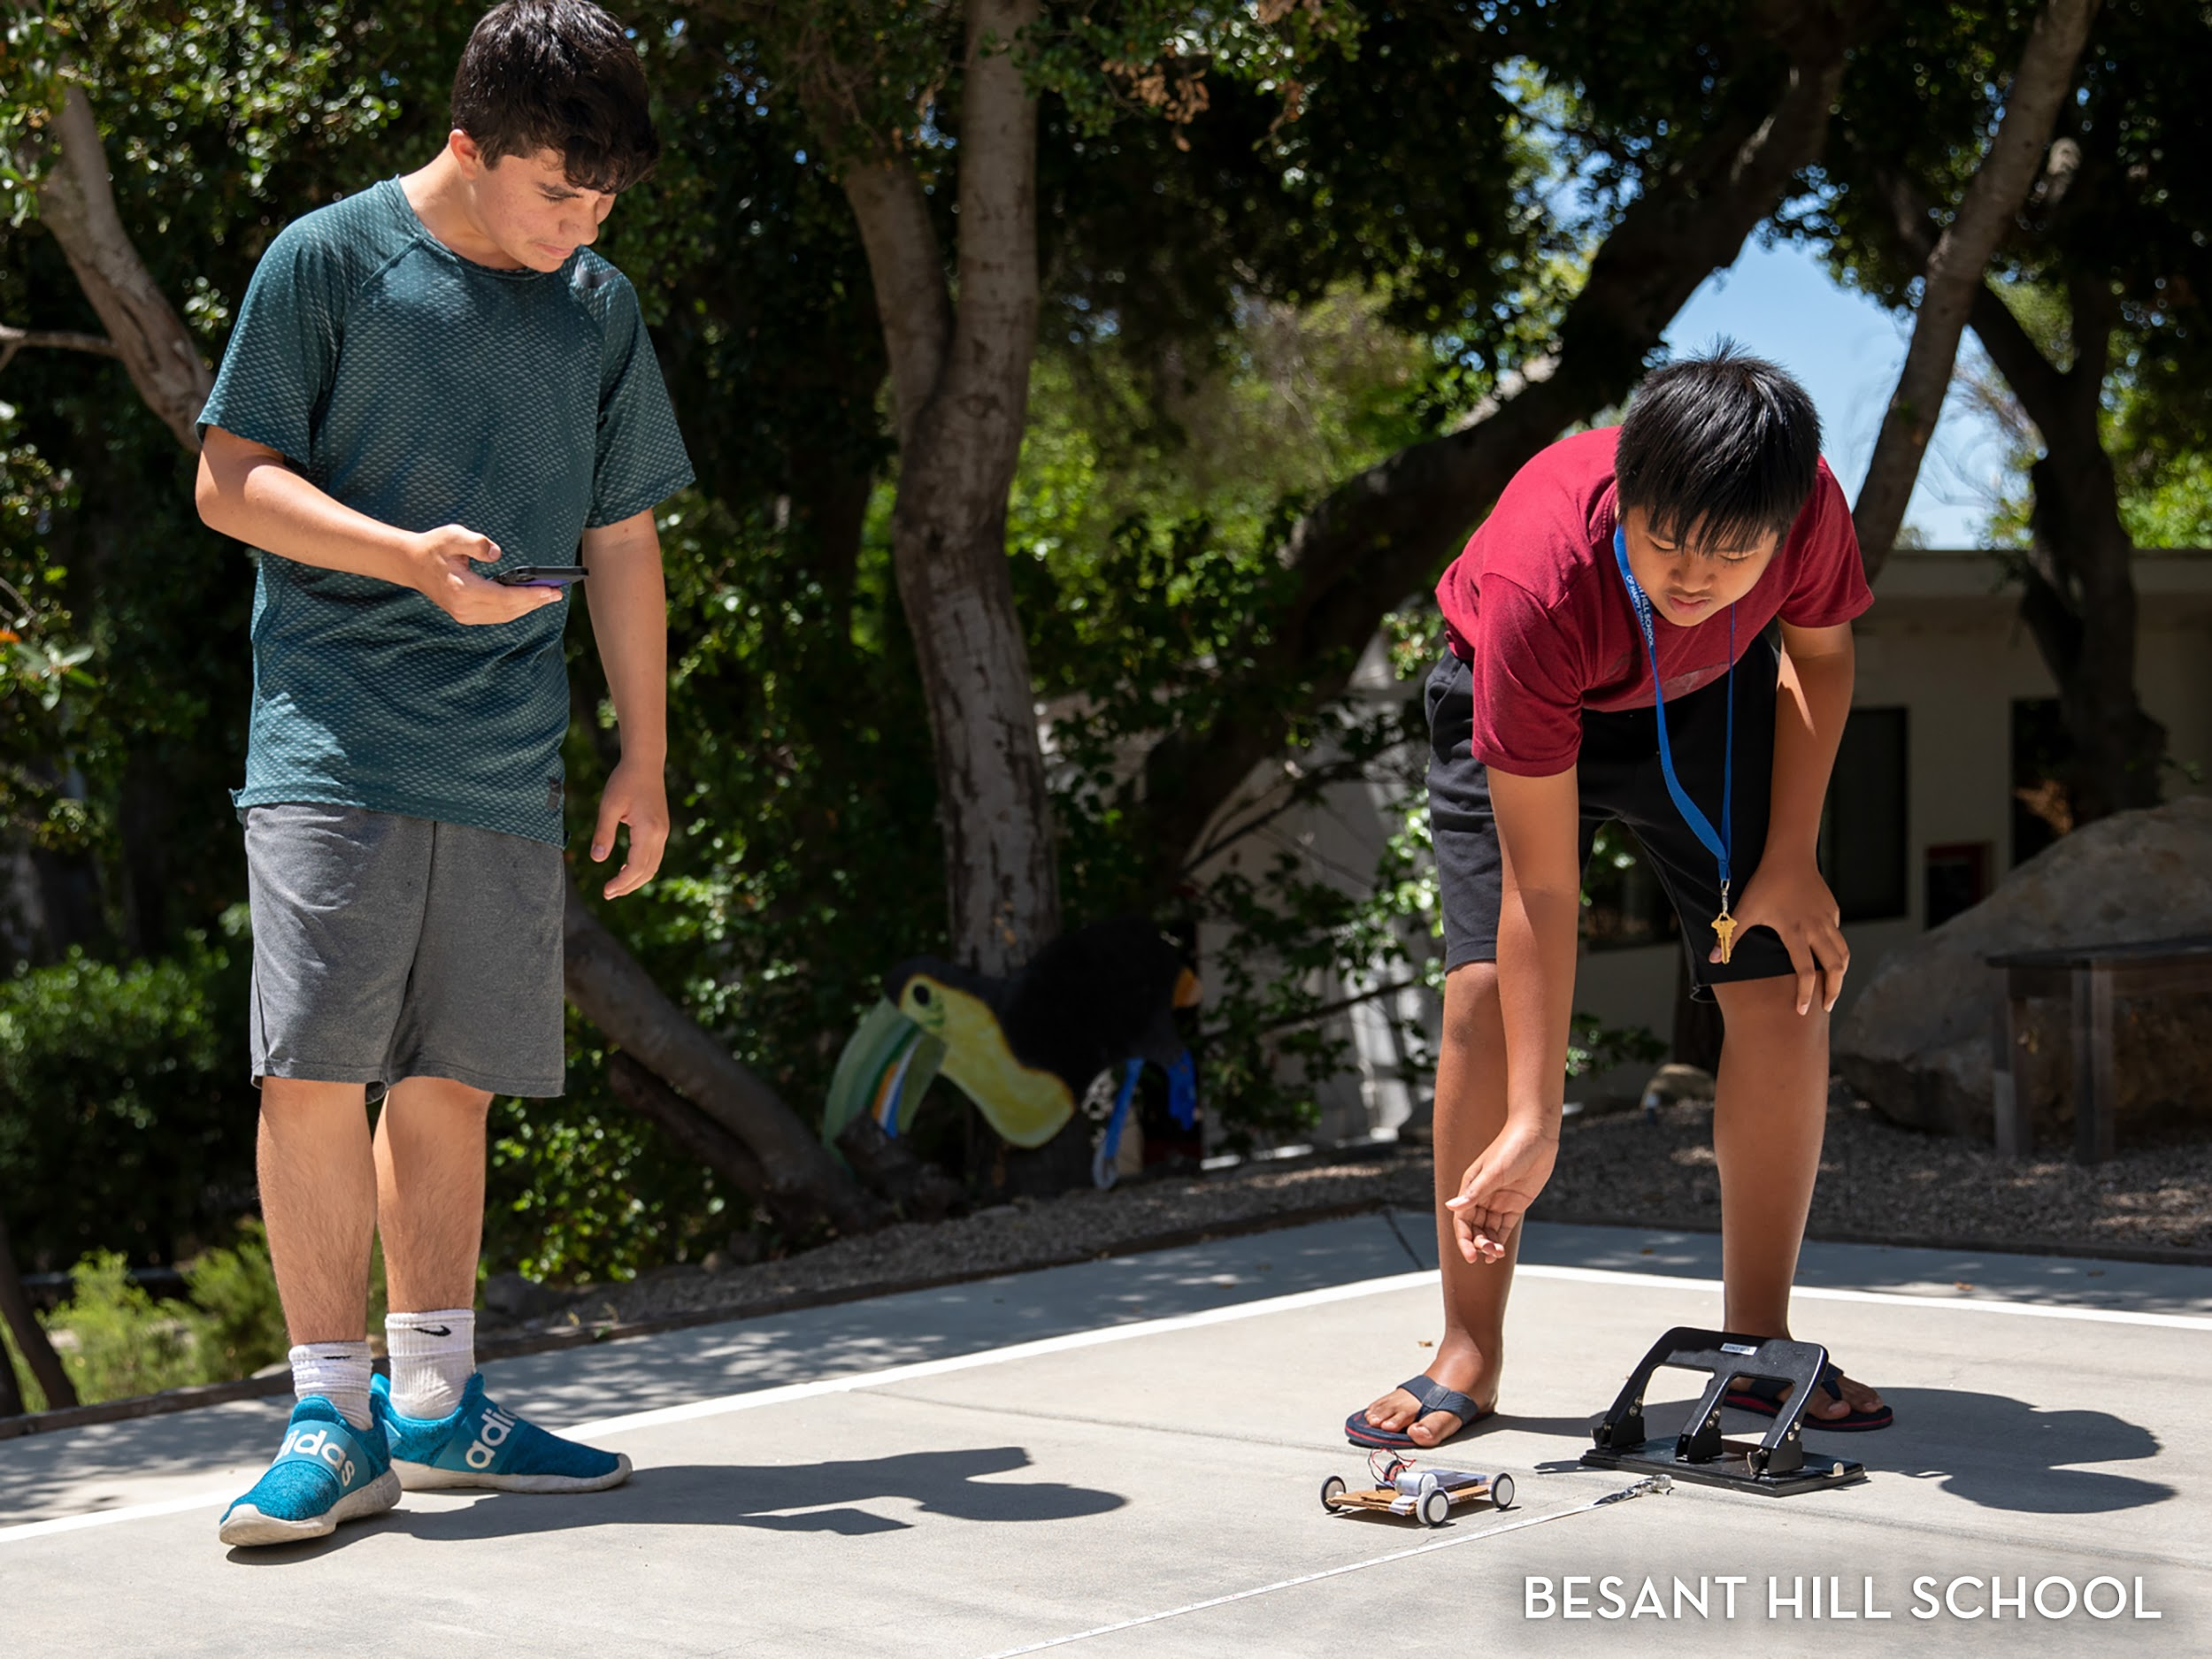
Notes:
We a traditional US high curriculum with AP level classes, SAT Prep and university placement. We offer all the sciences through the AP level. Given our location and land, our main strength is environmental science or sustainability. Those students interested in STEM related fields or environmental sciences, Besant Hill could be a wonderful option.

Slide 10
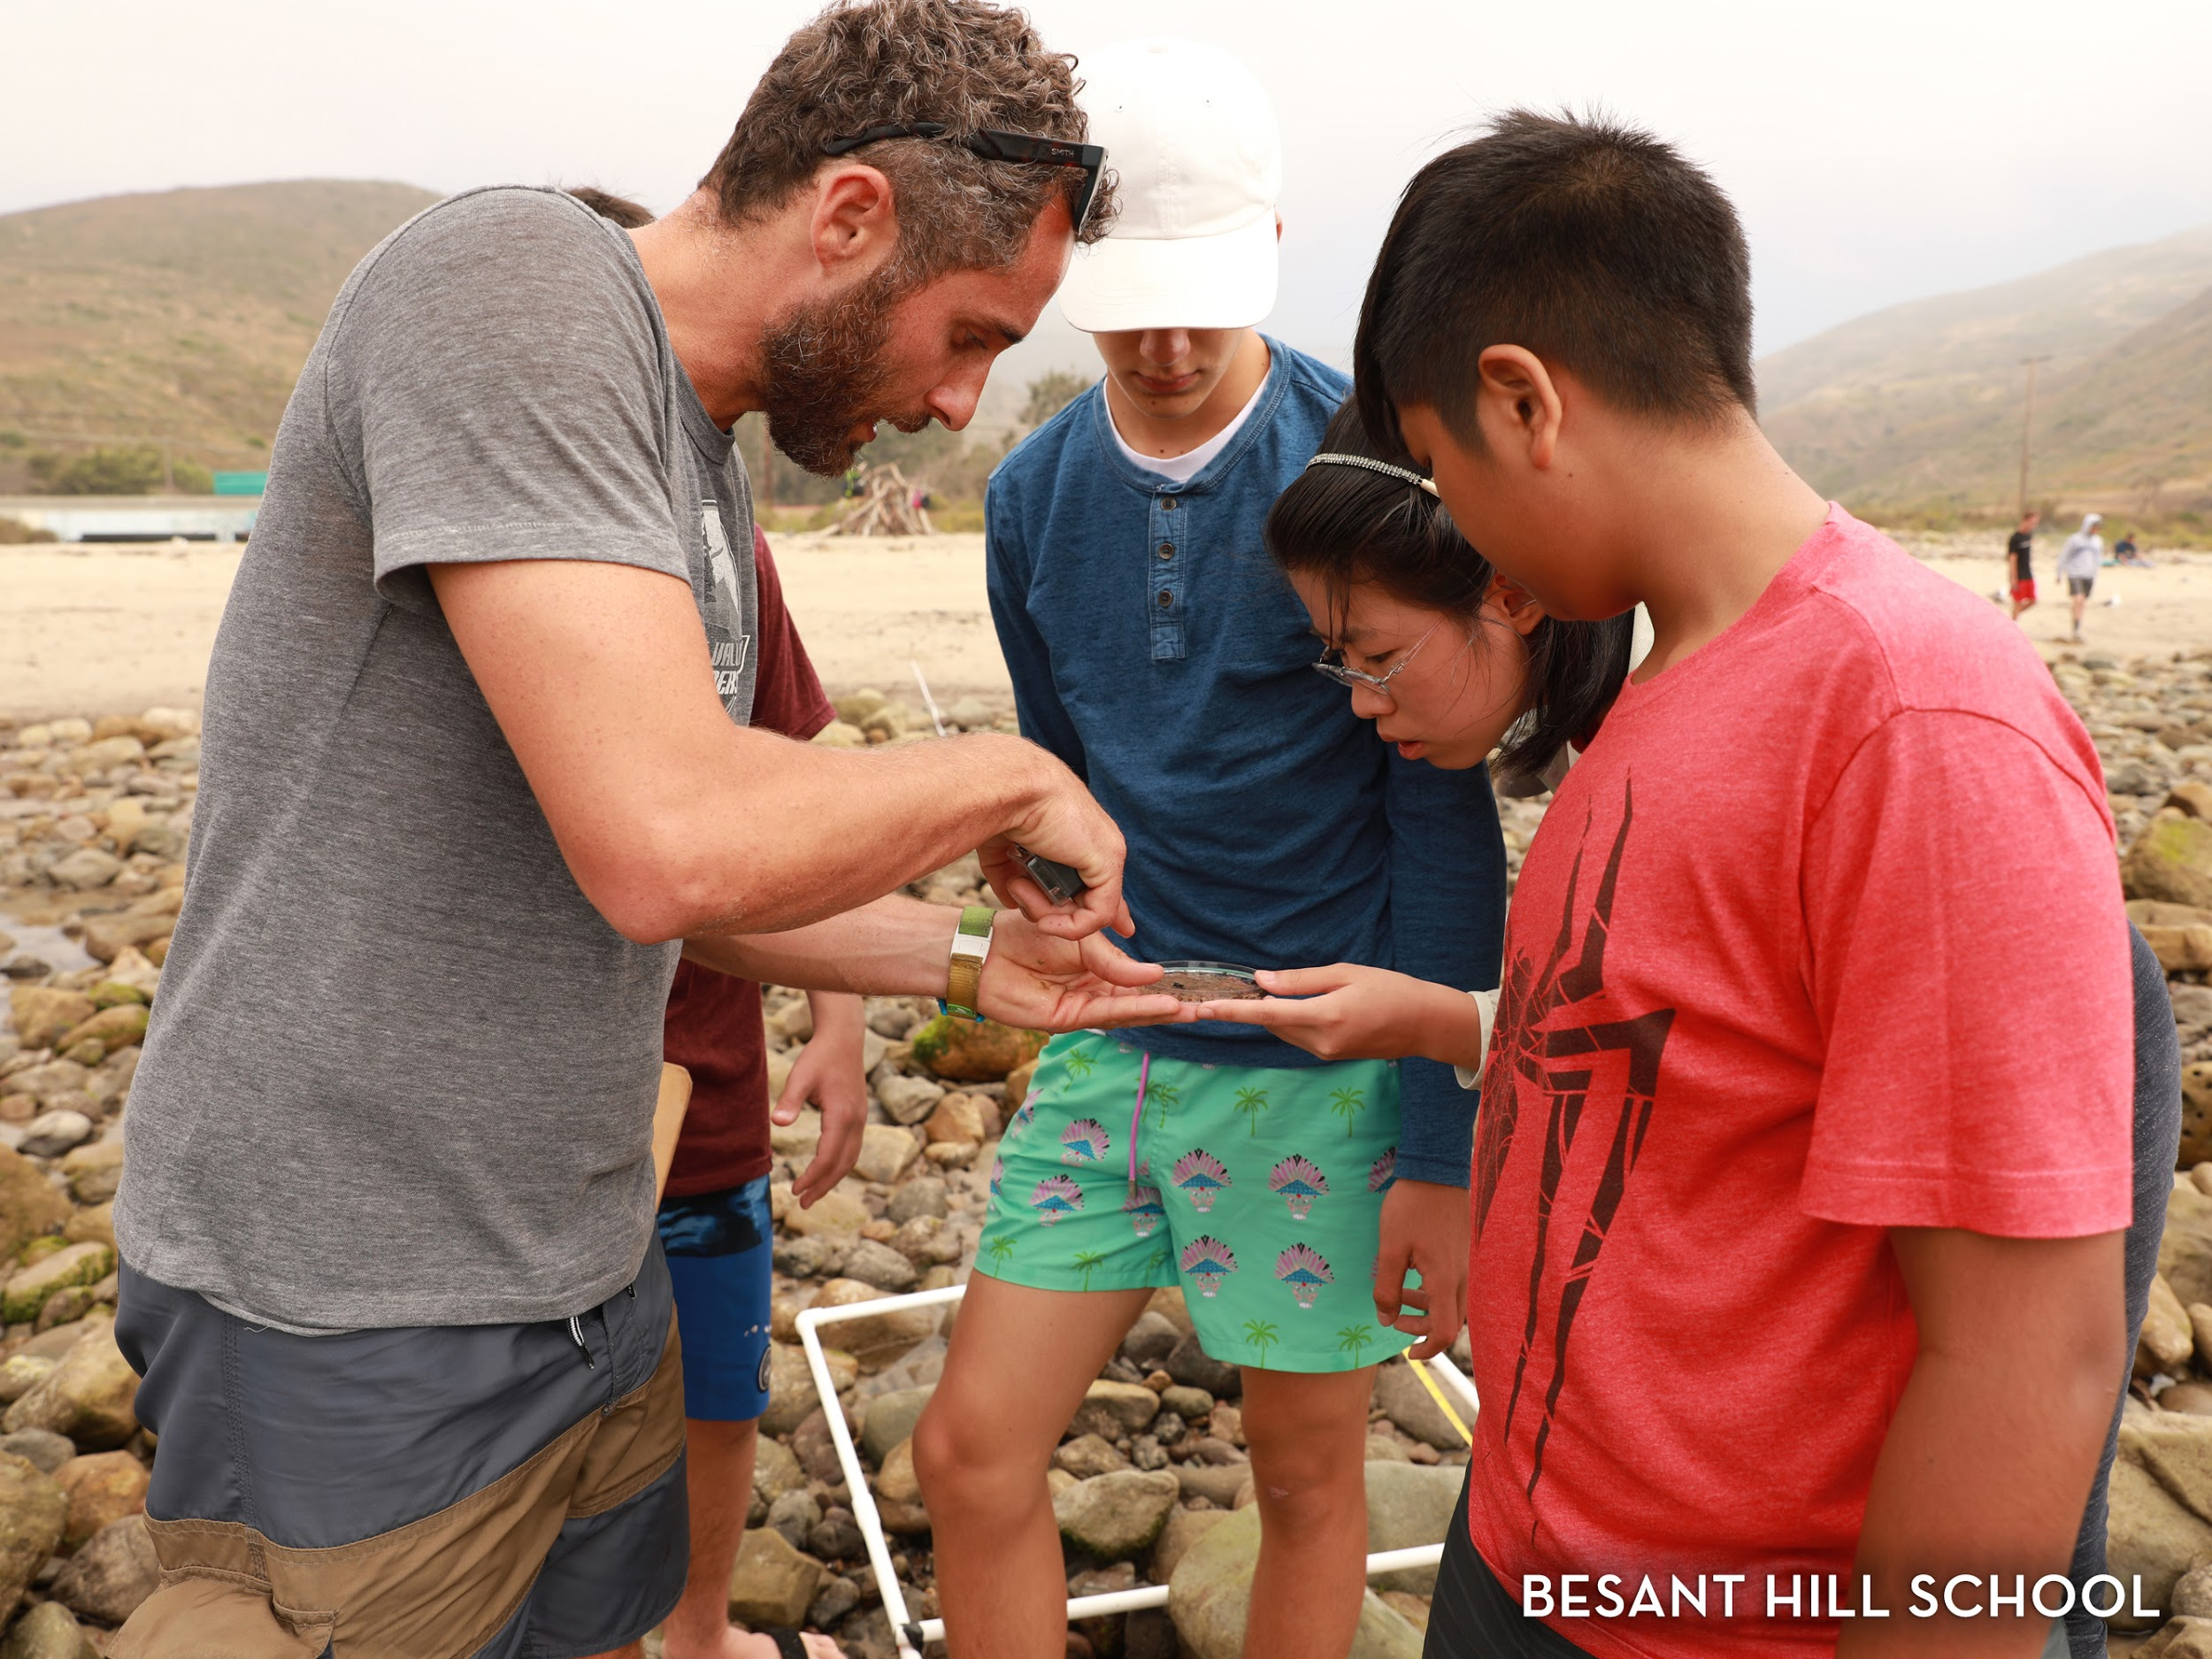
Notes:
There are students eager to engage in the sustainability initiative on campus and also help in the garden. BHS takes part in several environmental competitions with peer schools across the country. Beyond this, twice a year, we take a day to do project based work around the campus. This is an opportunity for everyone to be involved in keeping the campus beautiful.

Slide 11
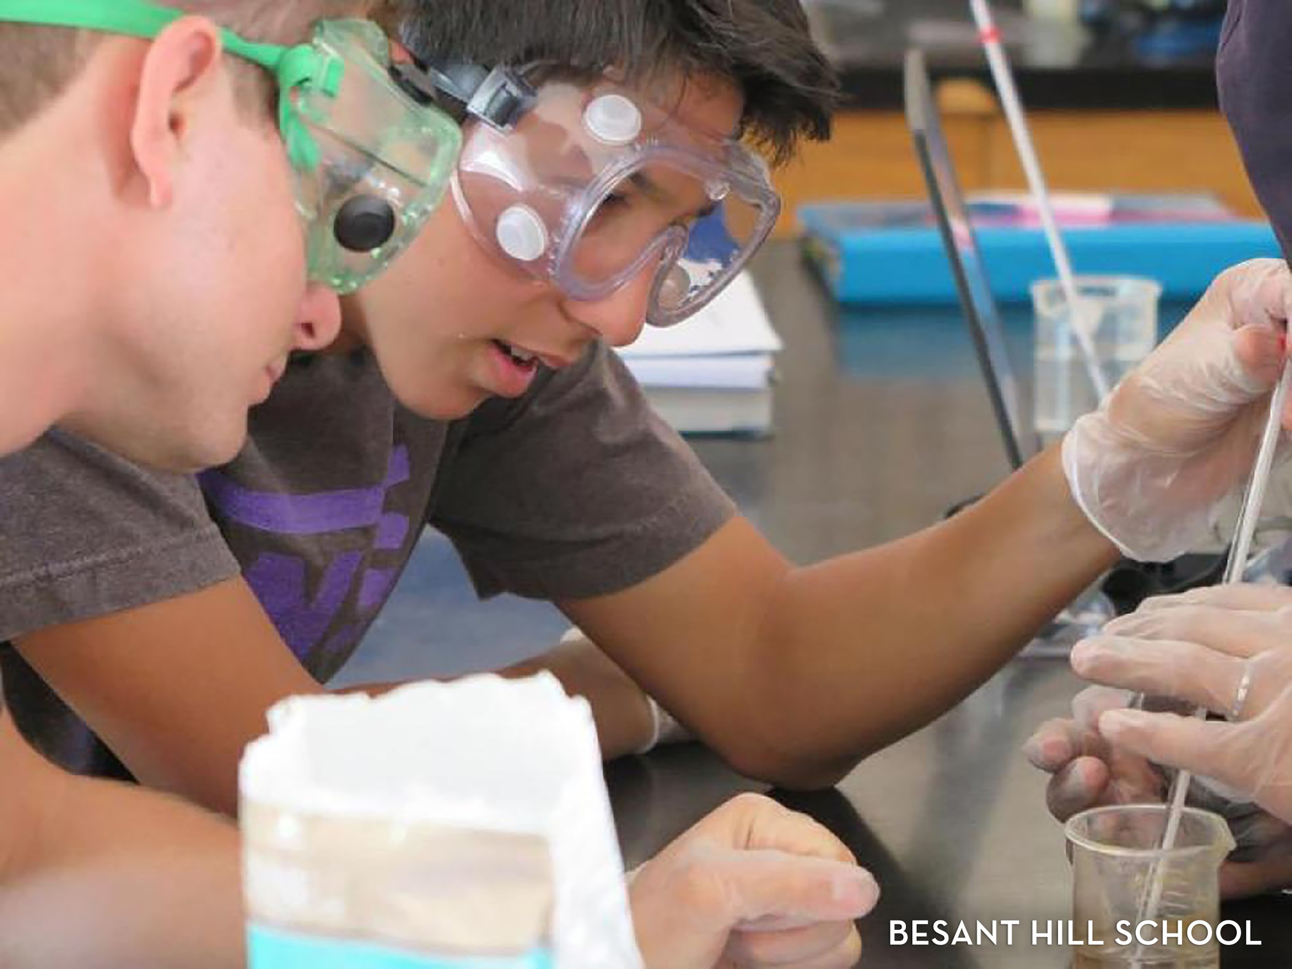

Slide 12


Slide 13
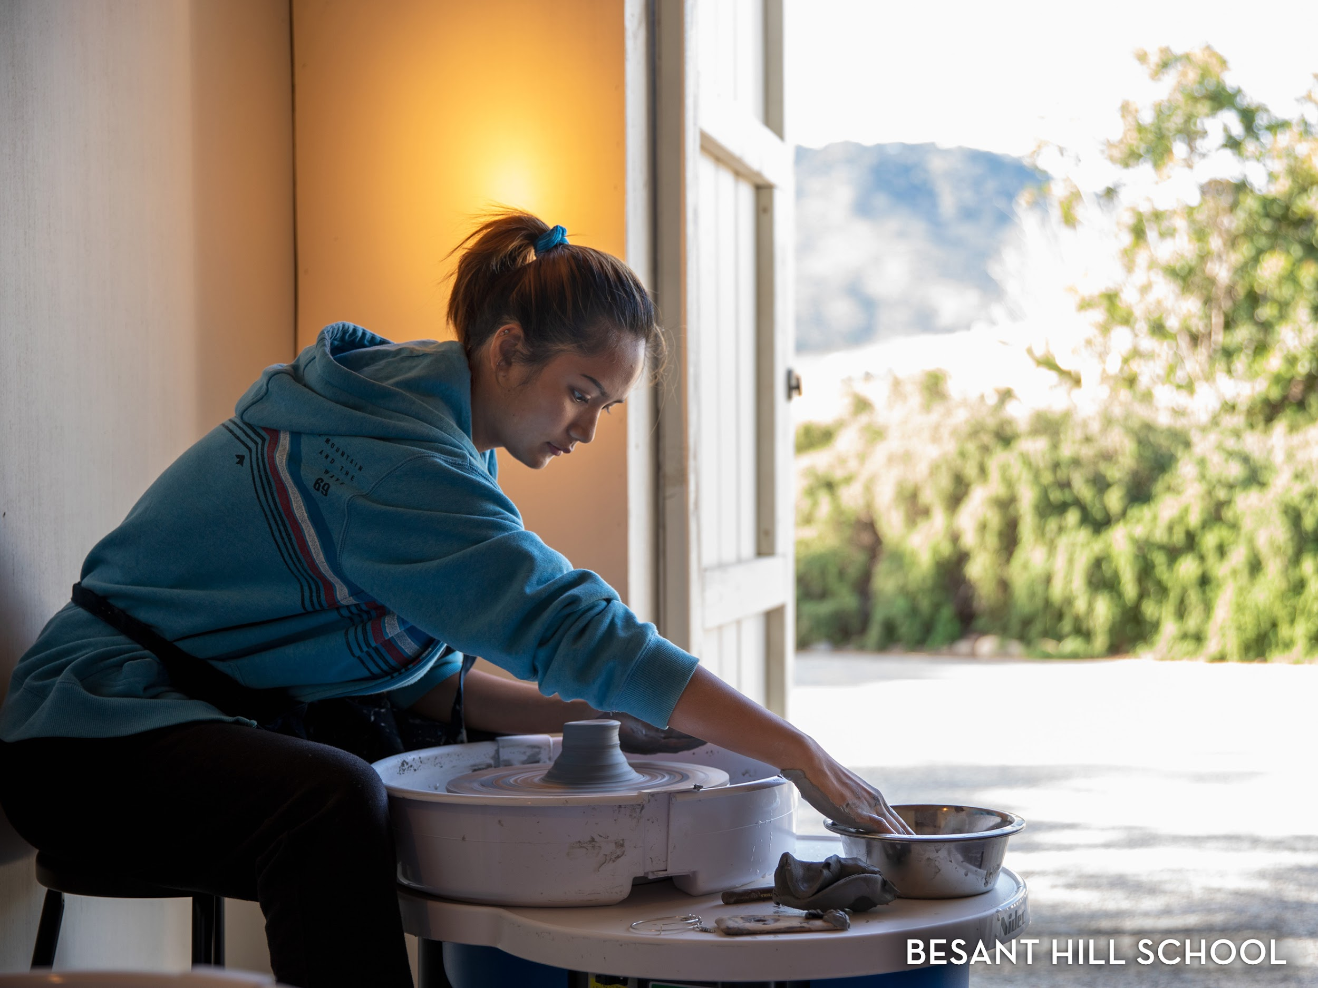

Slide 14
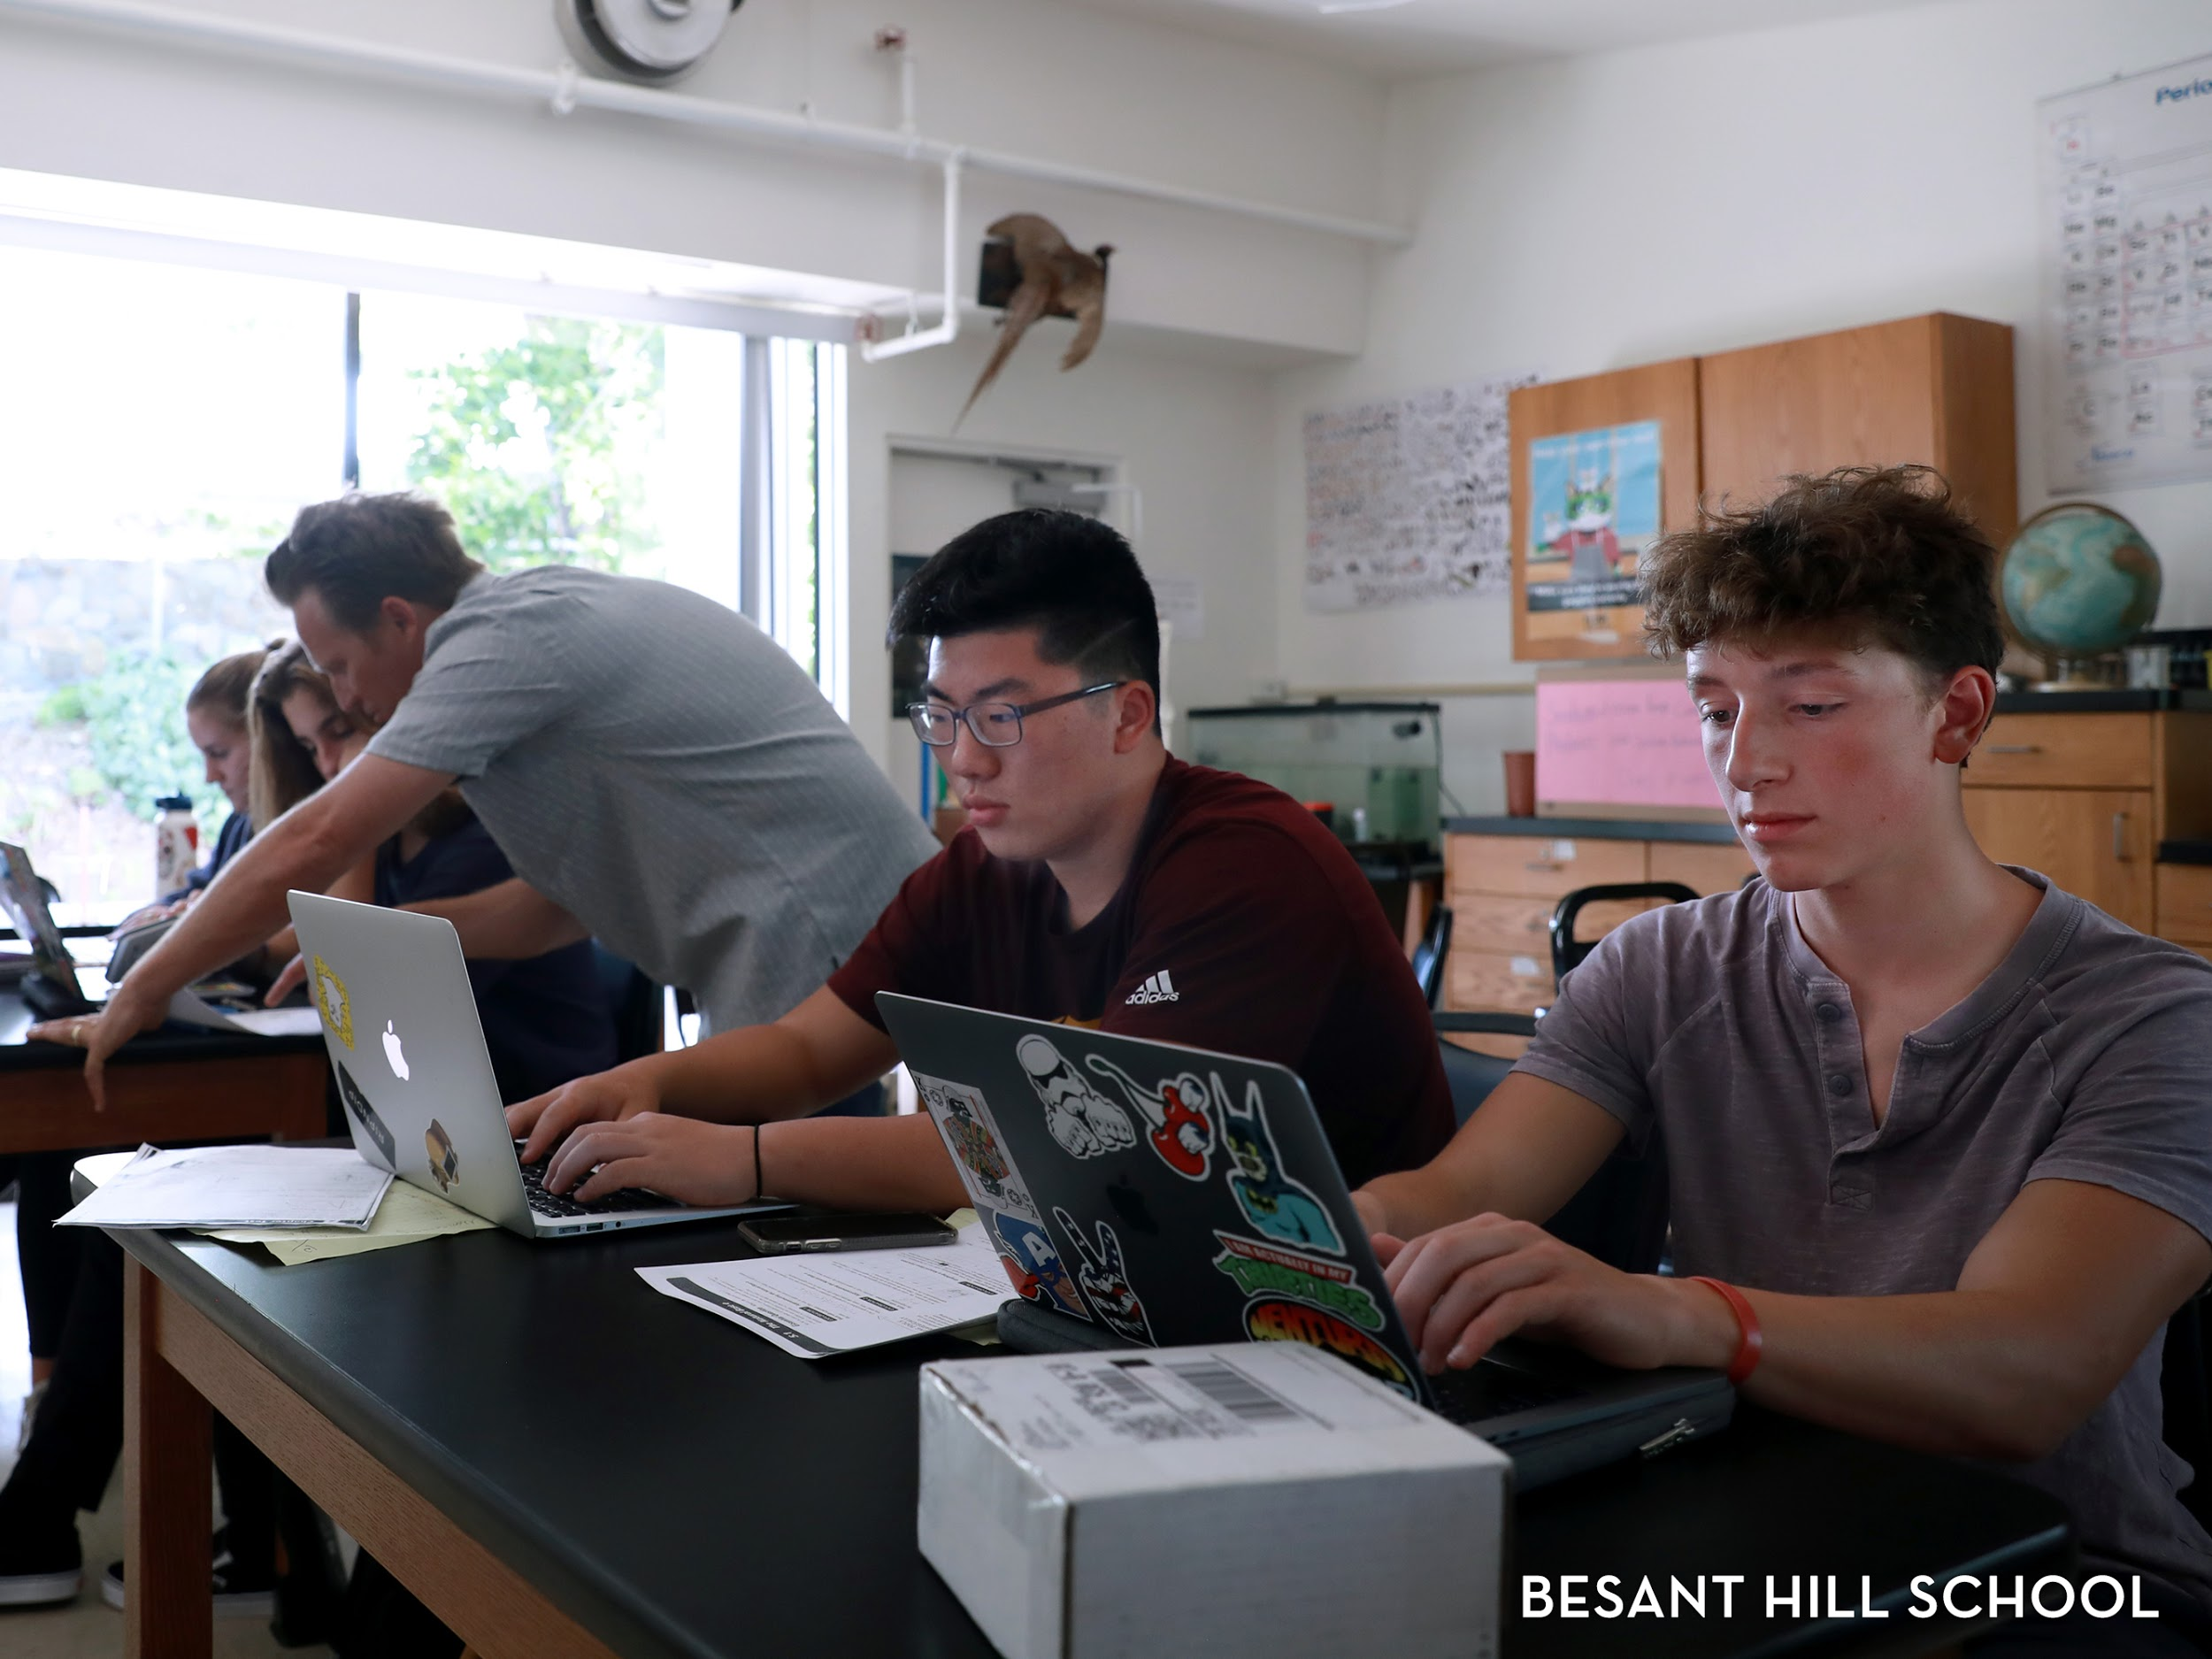

Slide 15
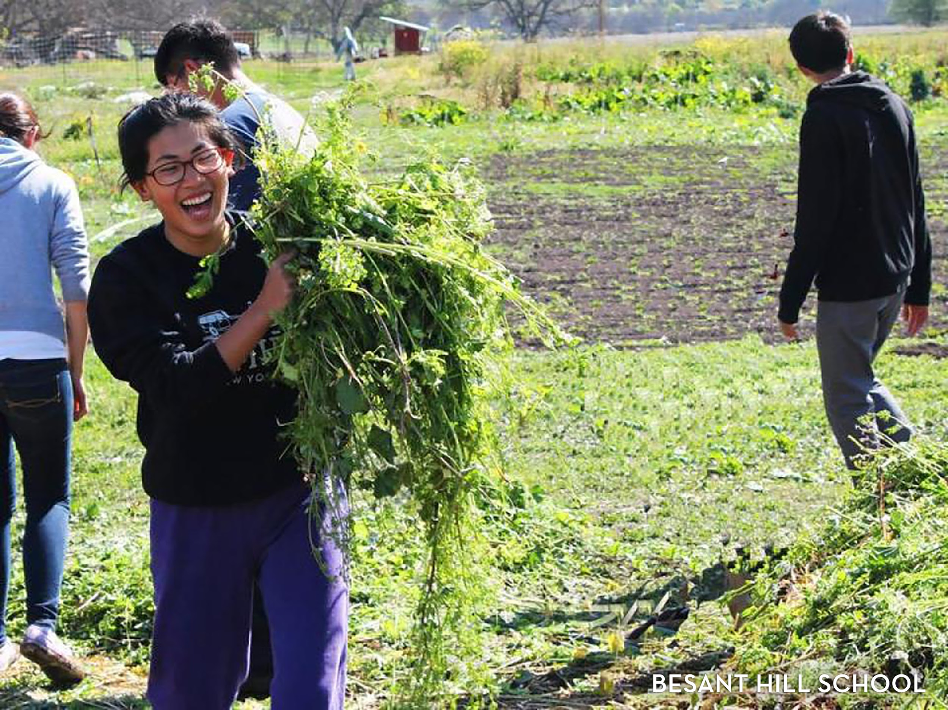

Slide 16
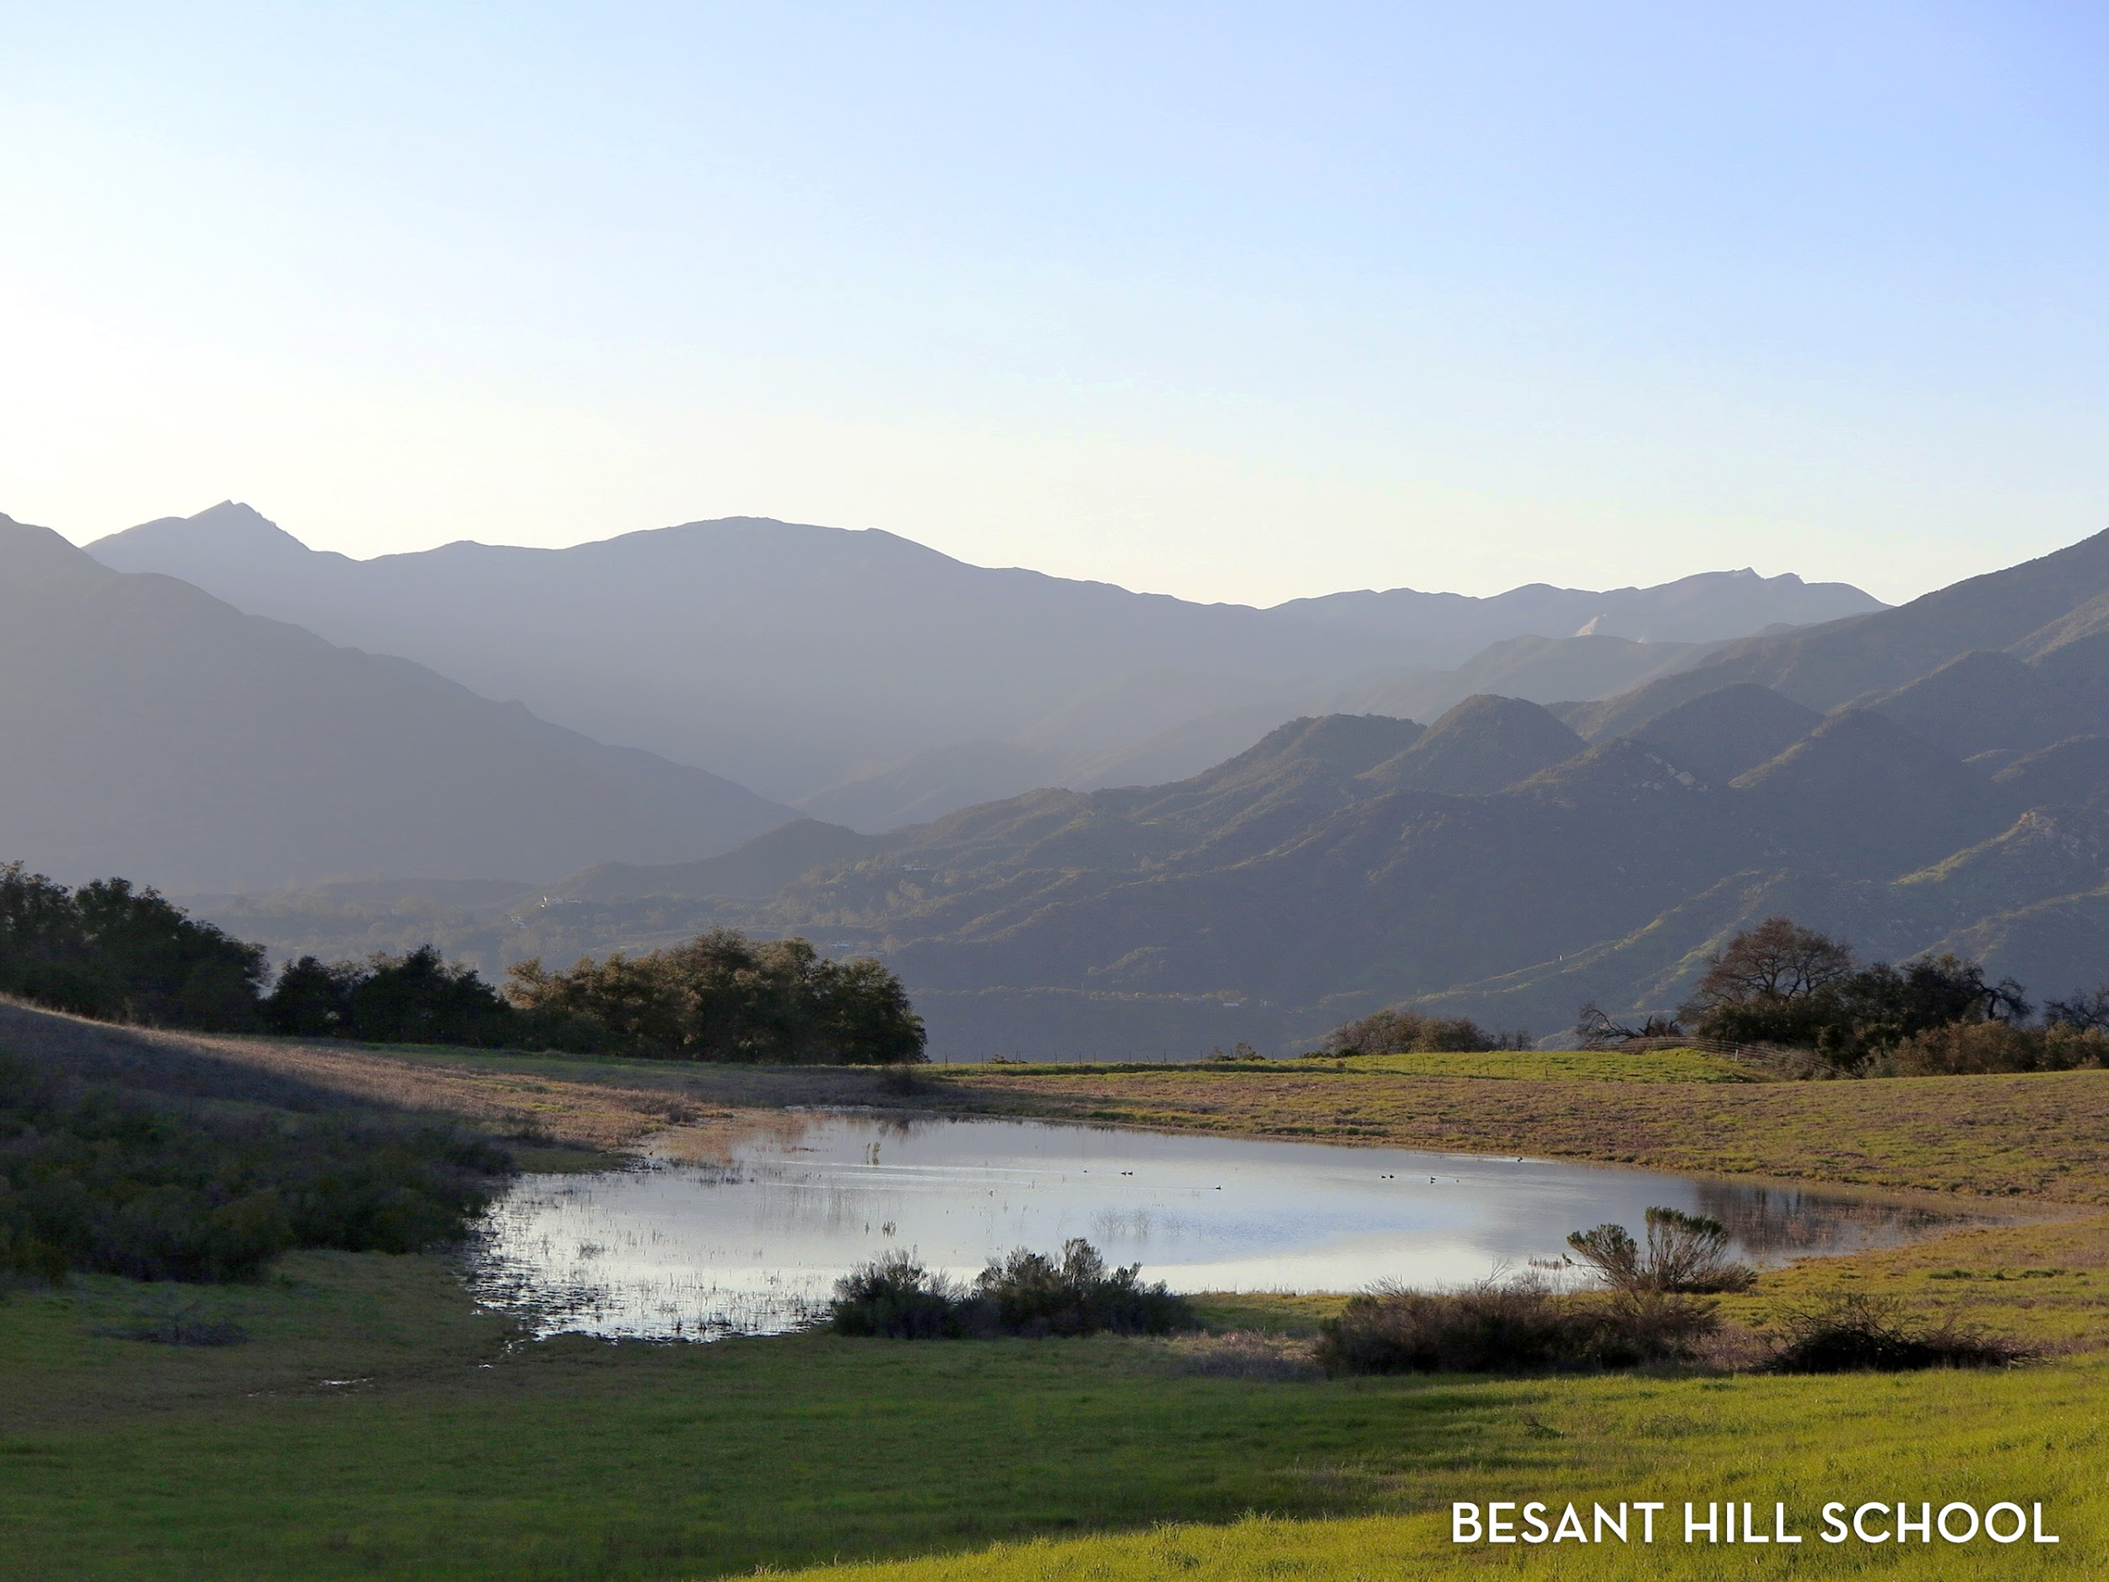

Slide 17


Slide 18
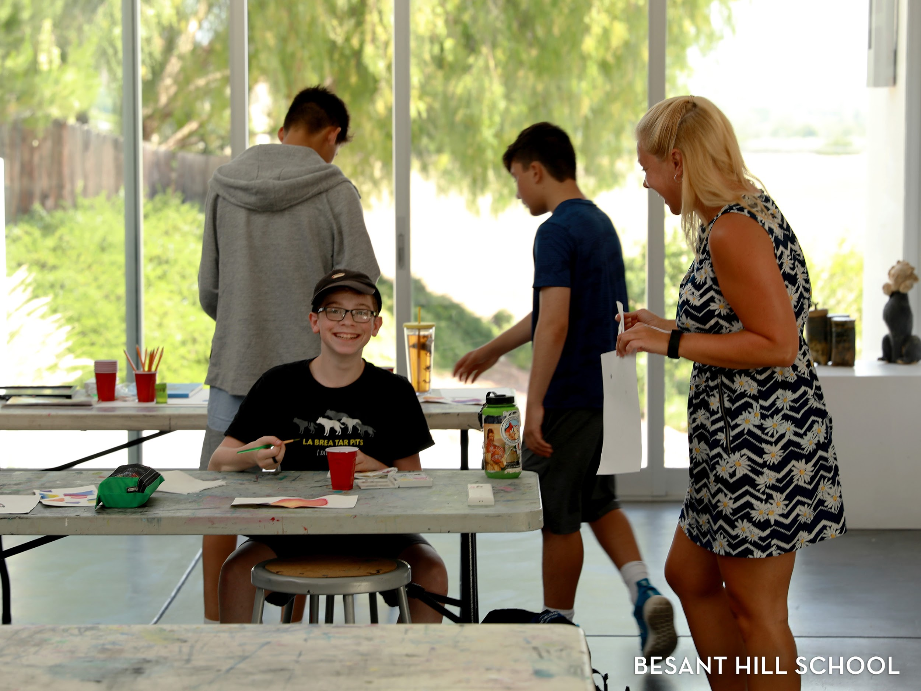

Slide 19


Slide 20
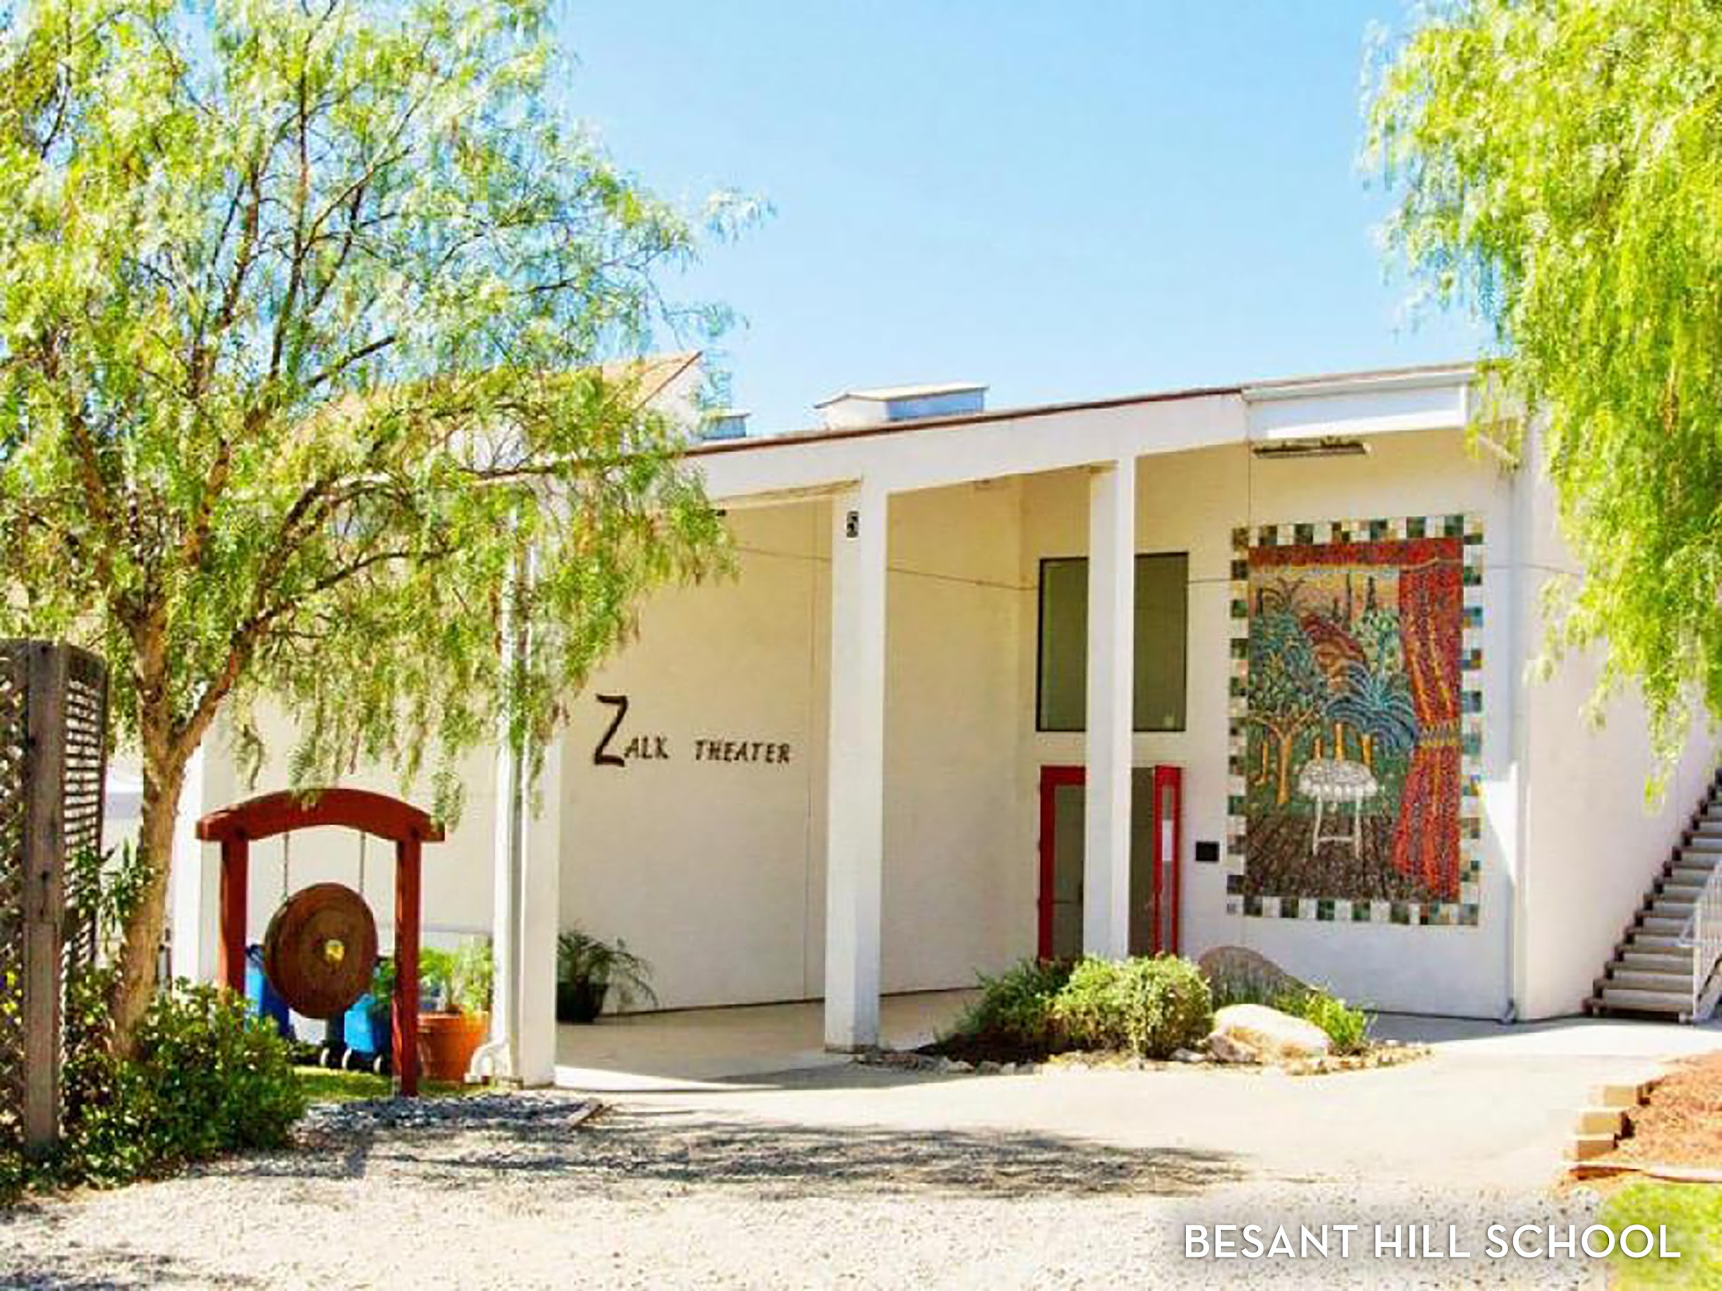

Slide 21


Slide 22


Slide 23
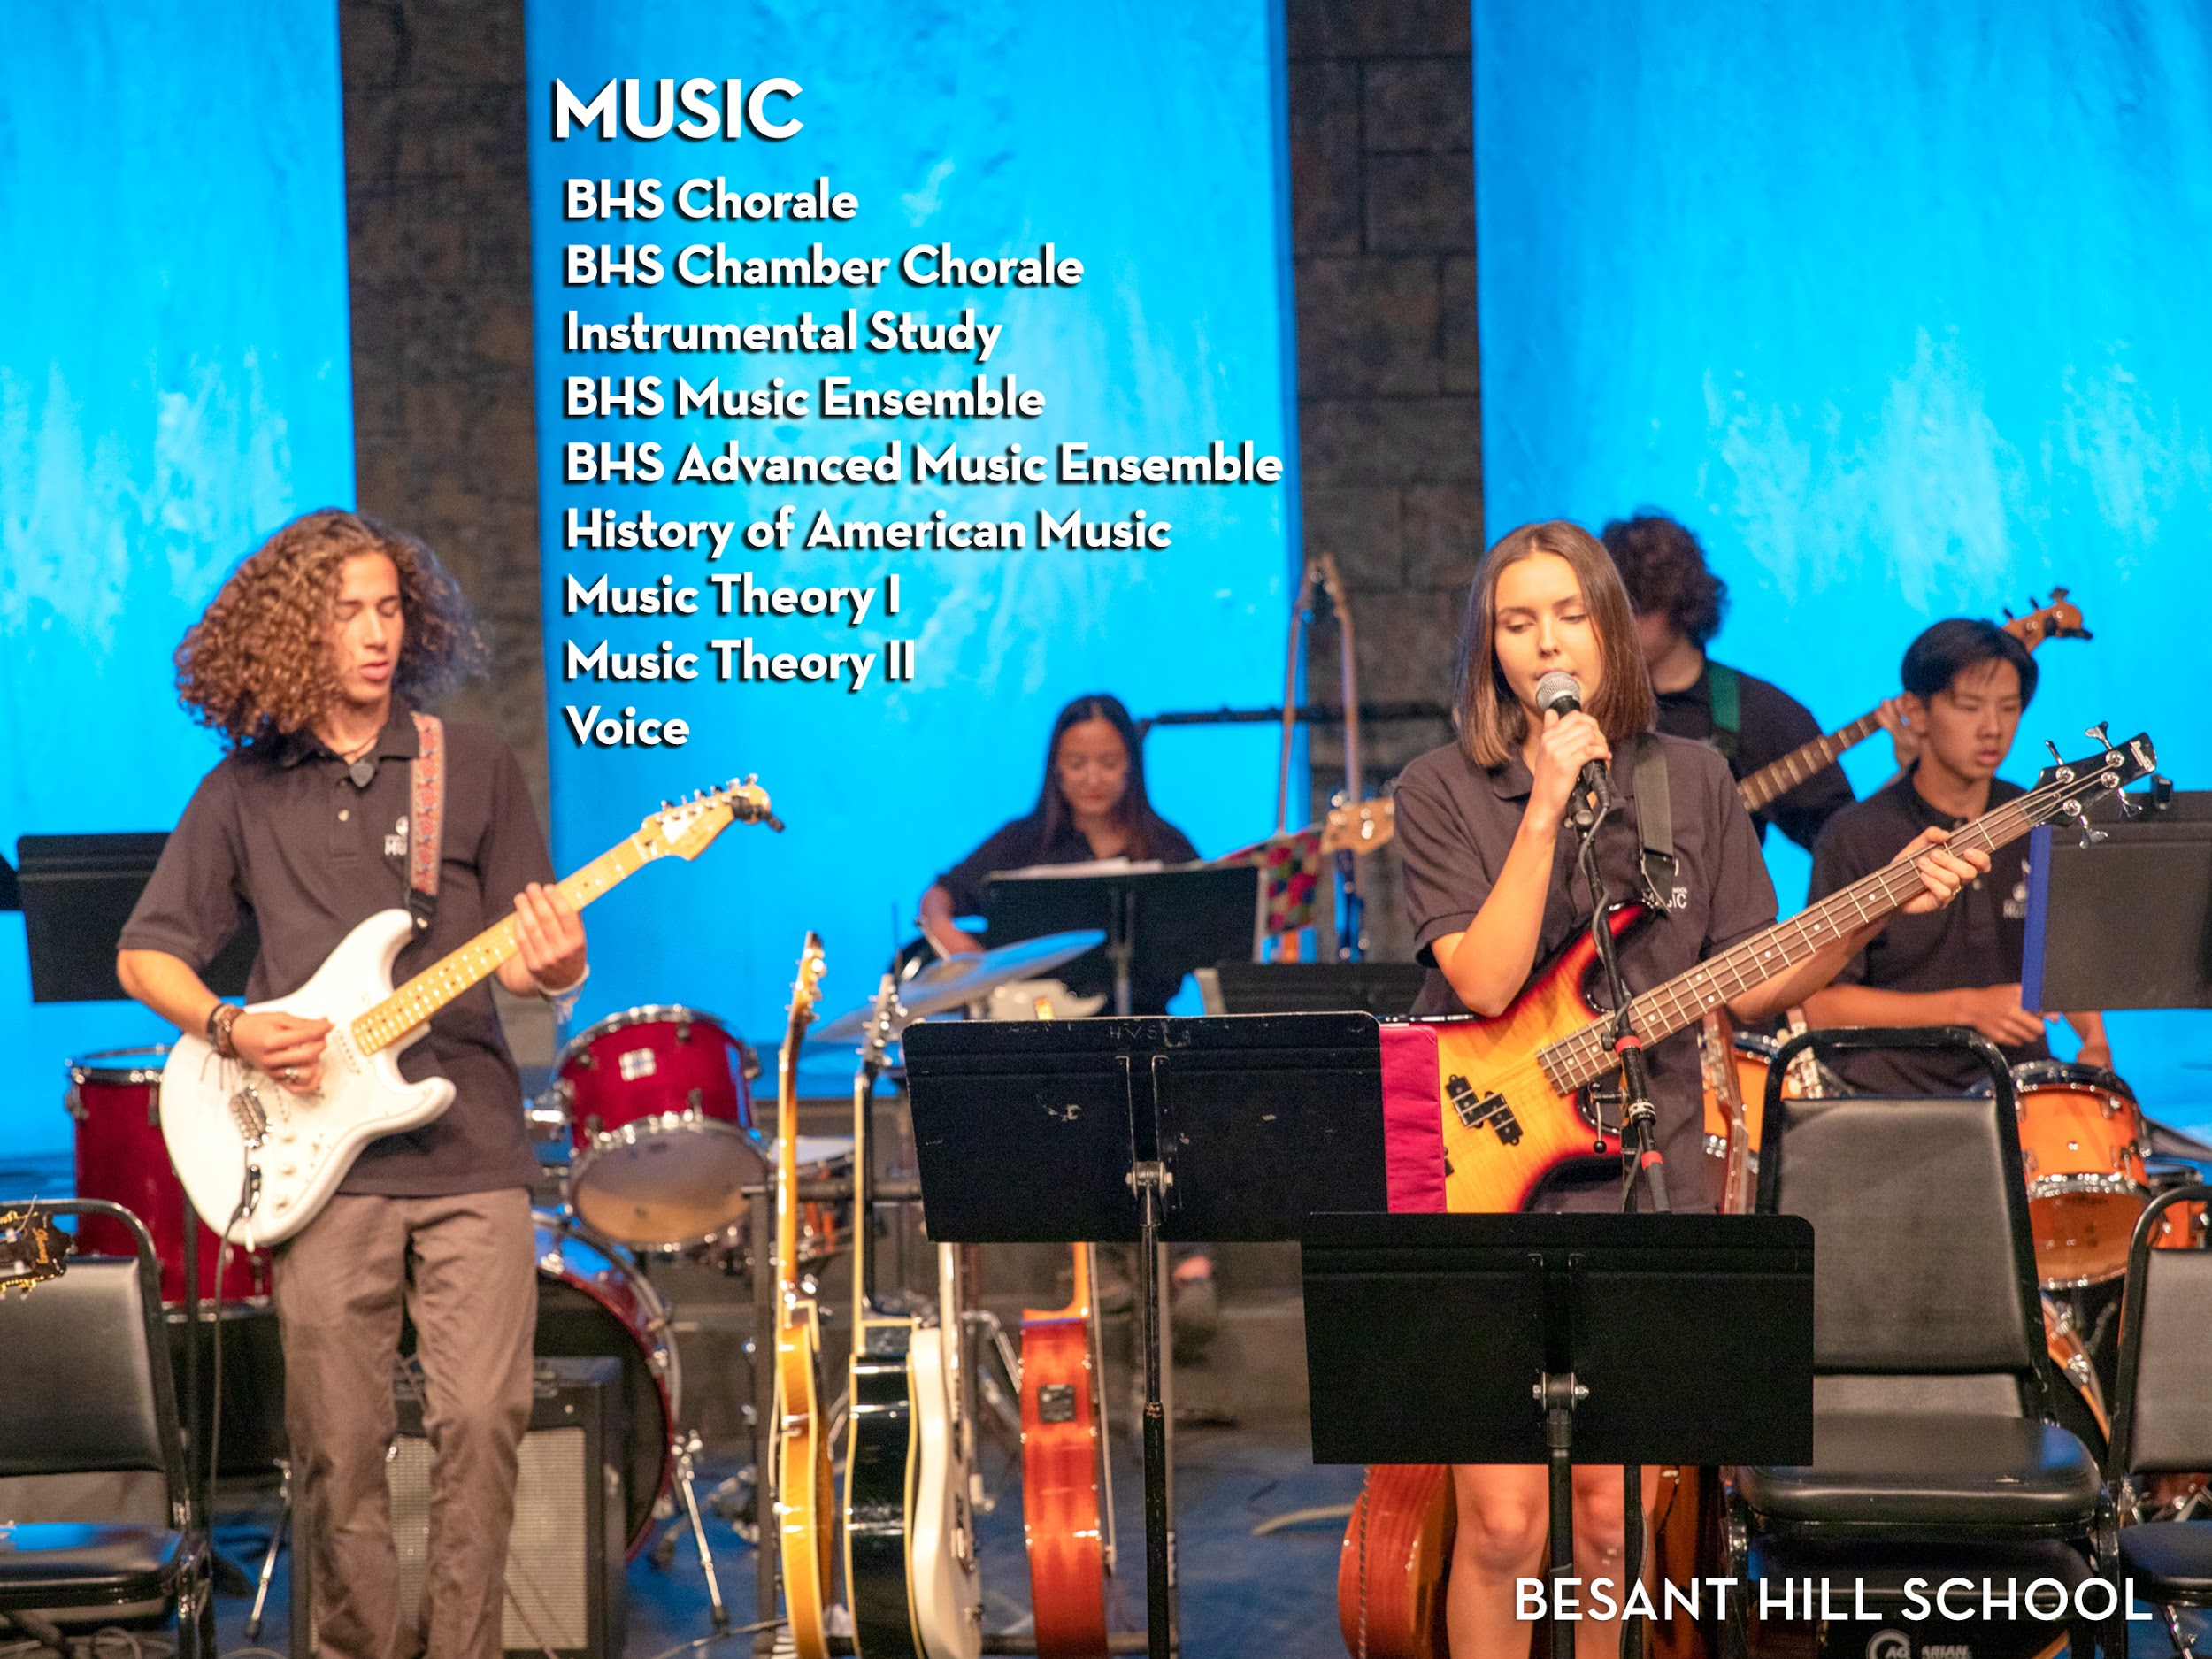

Slide 24
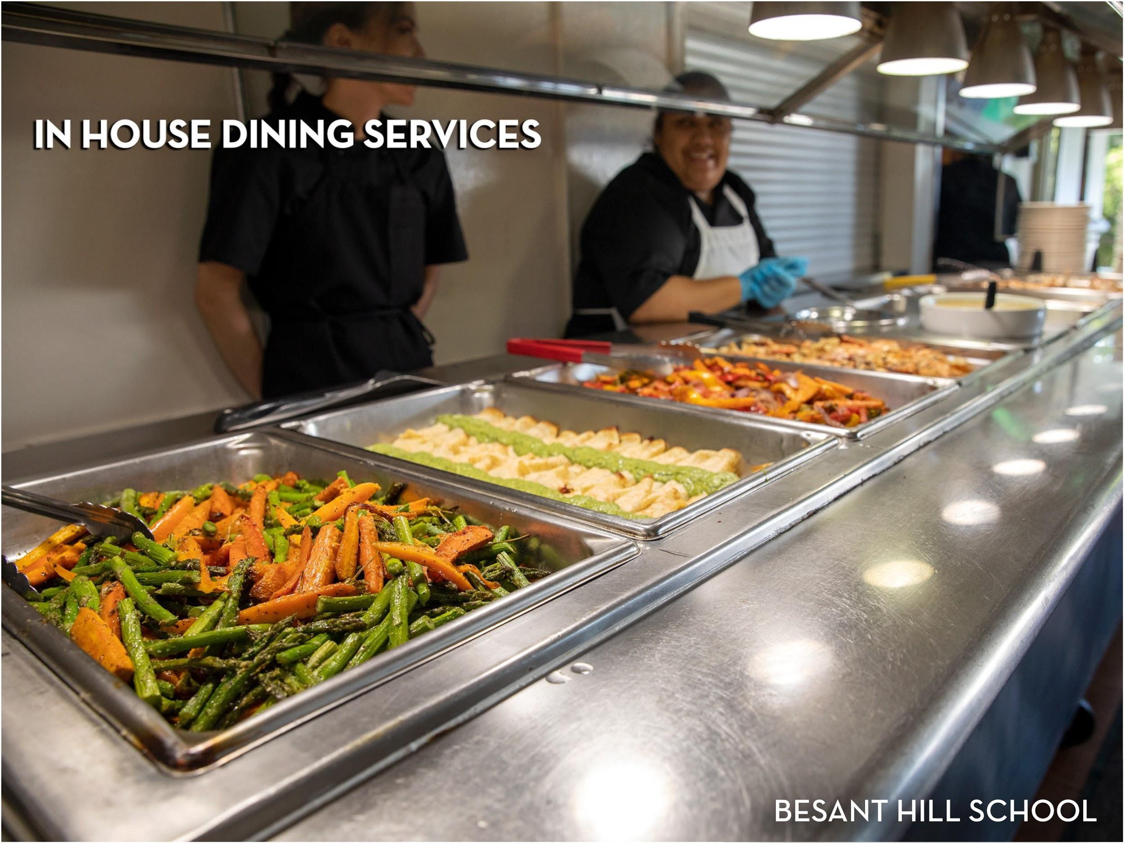

Slide 25


Slide 26


Slide 27
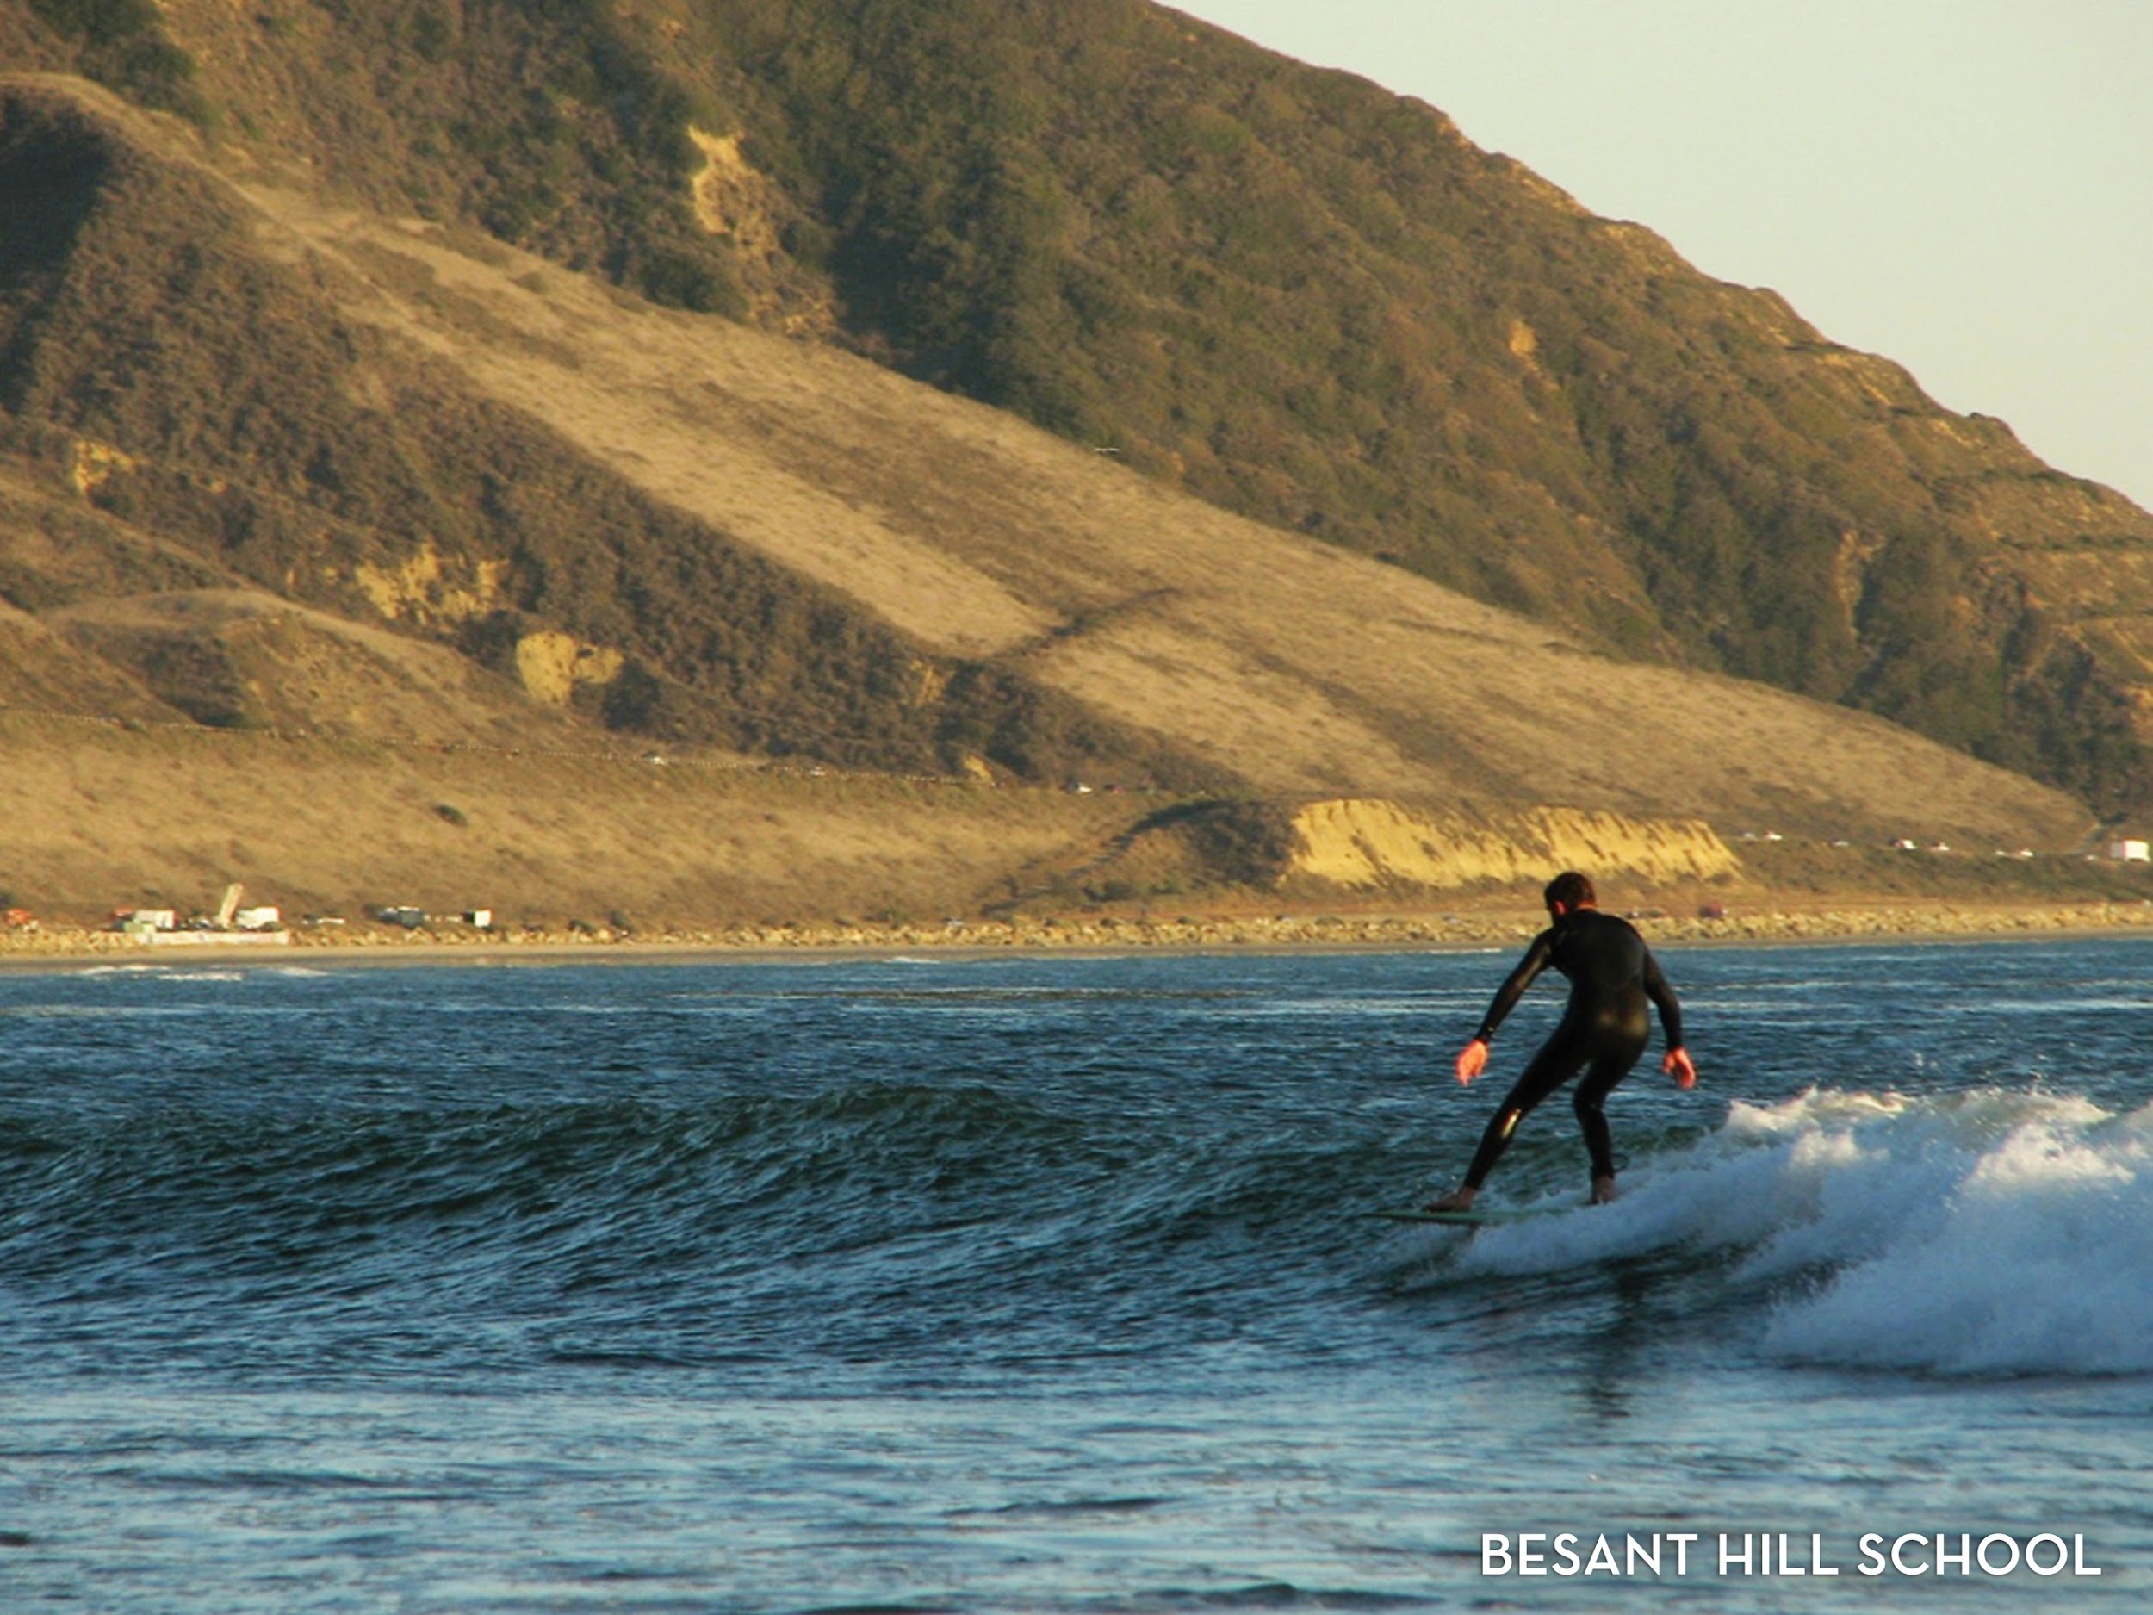

Slide 28
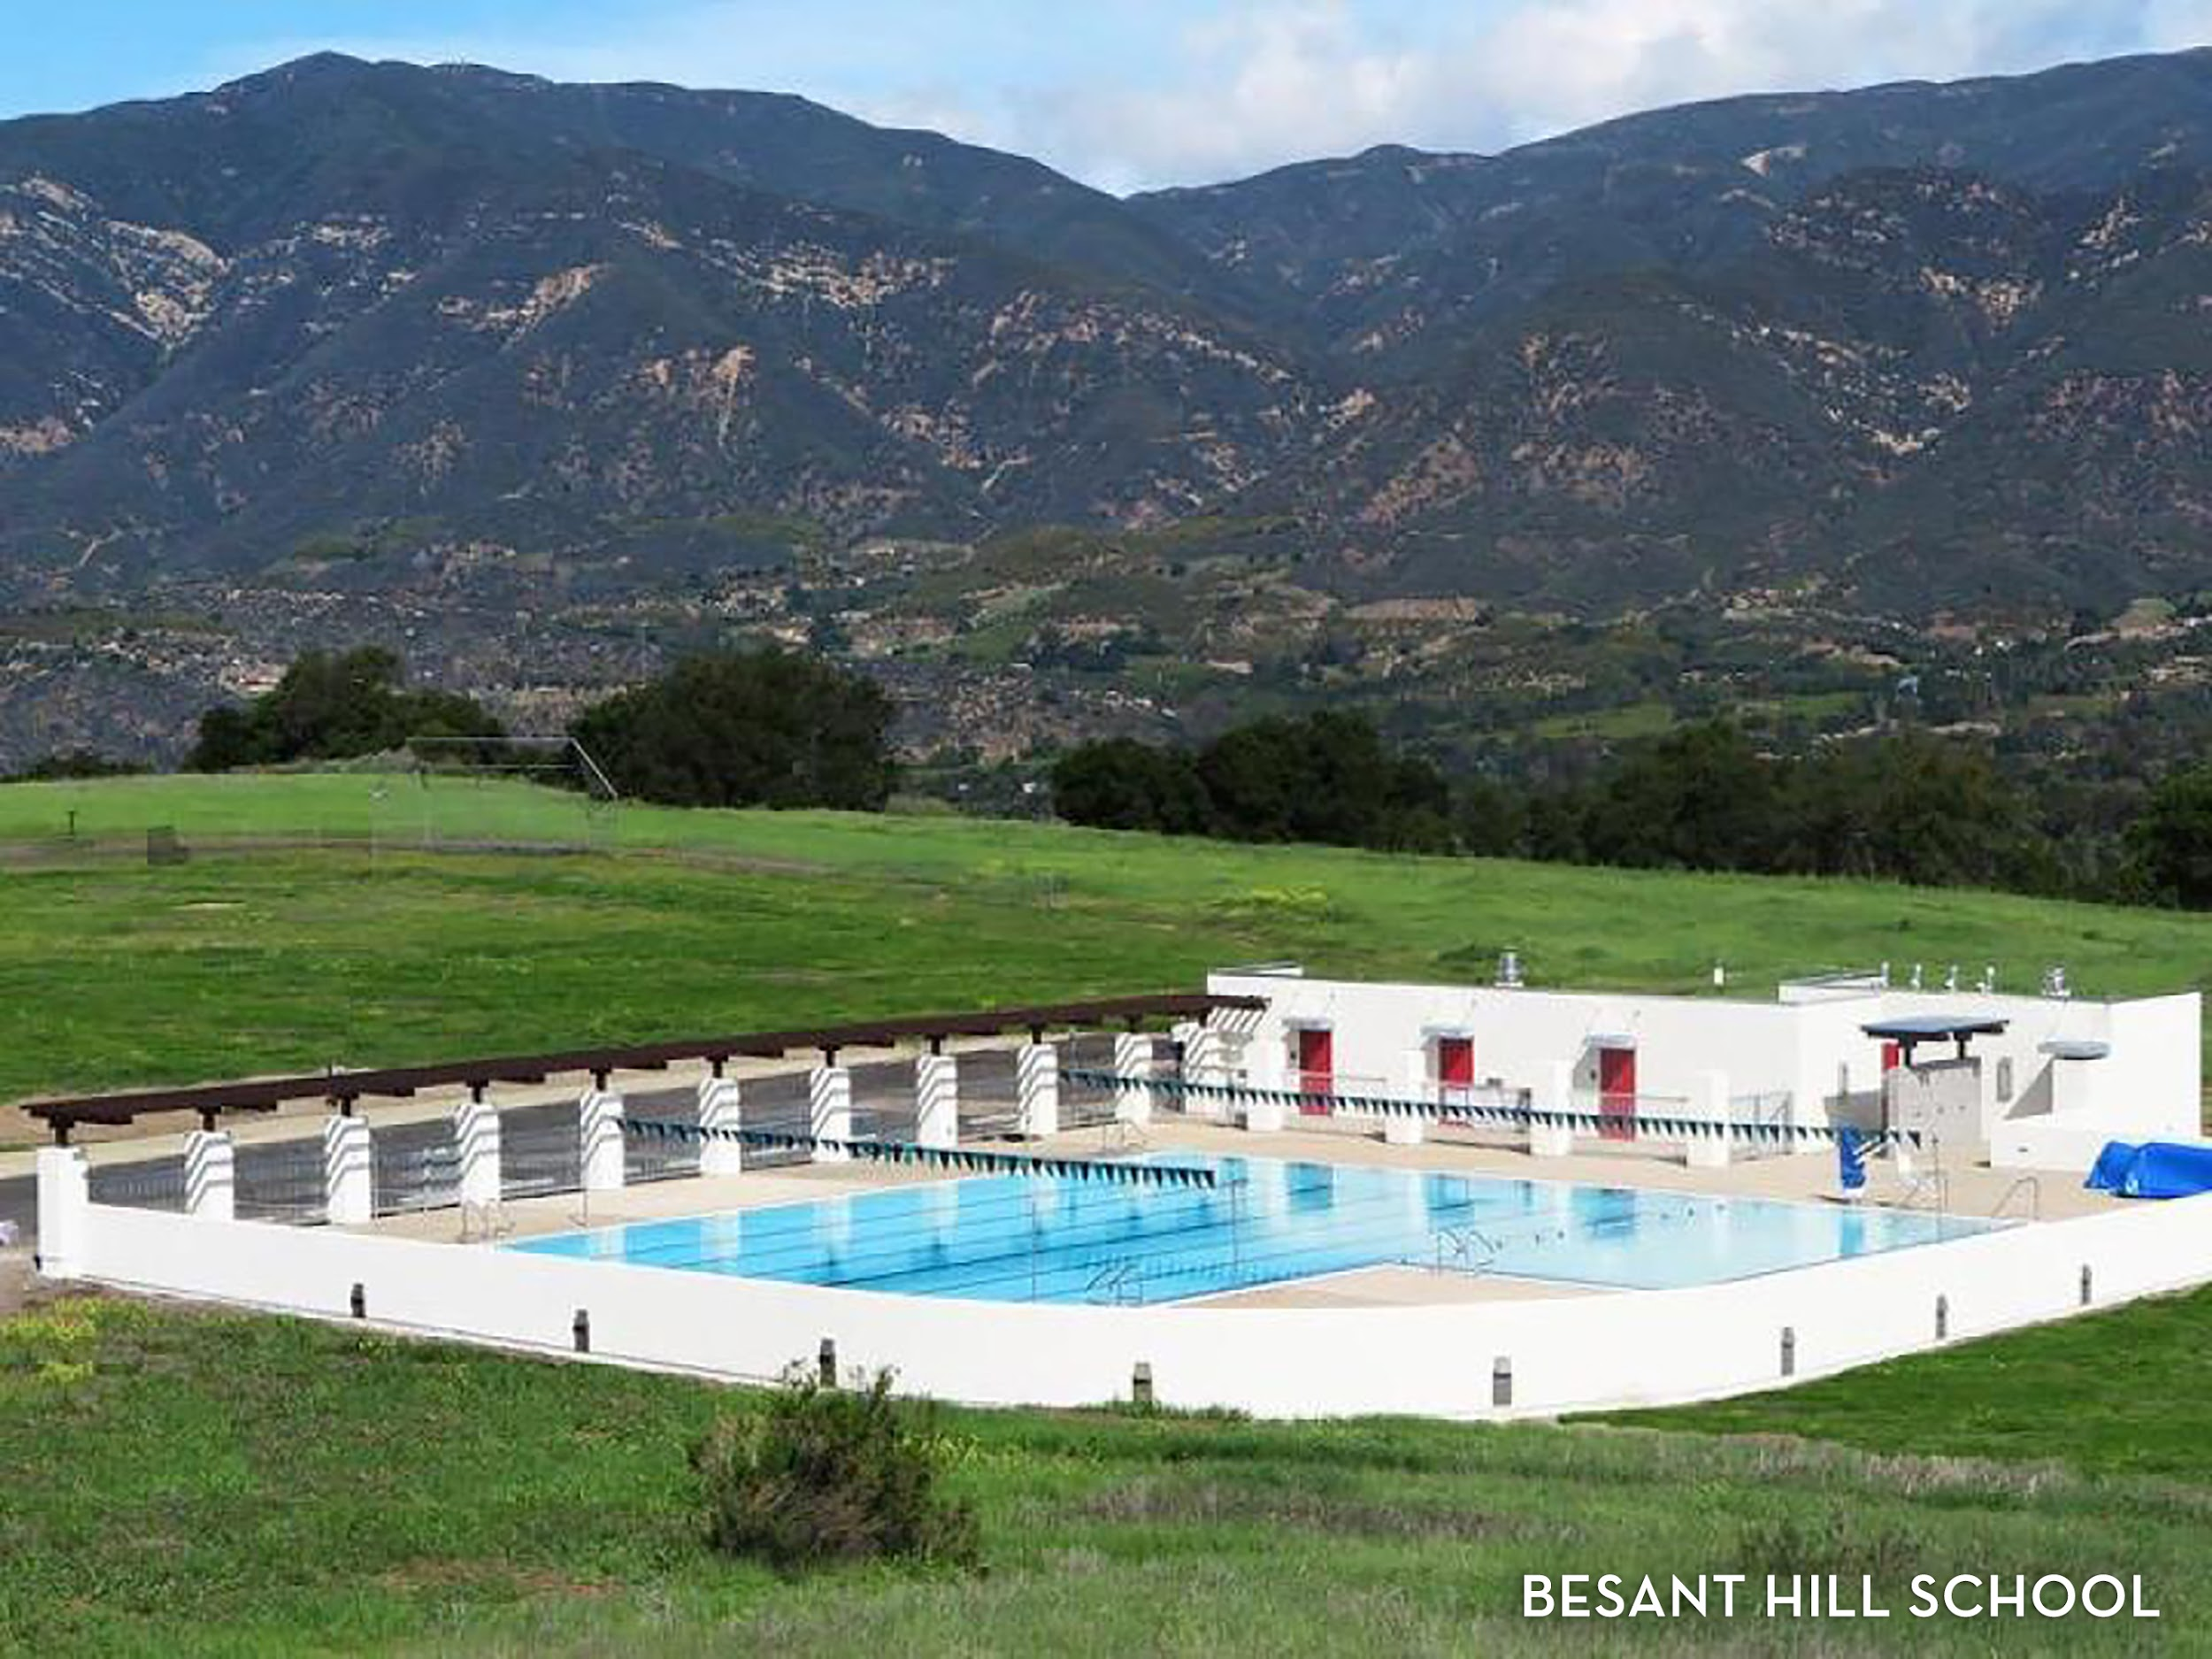

Slide 29
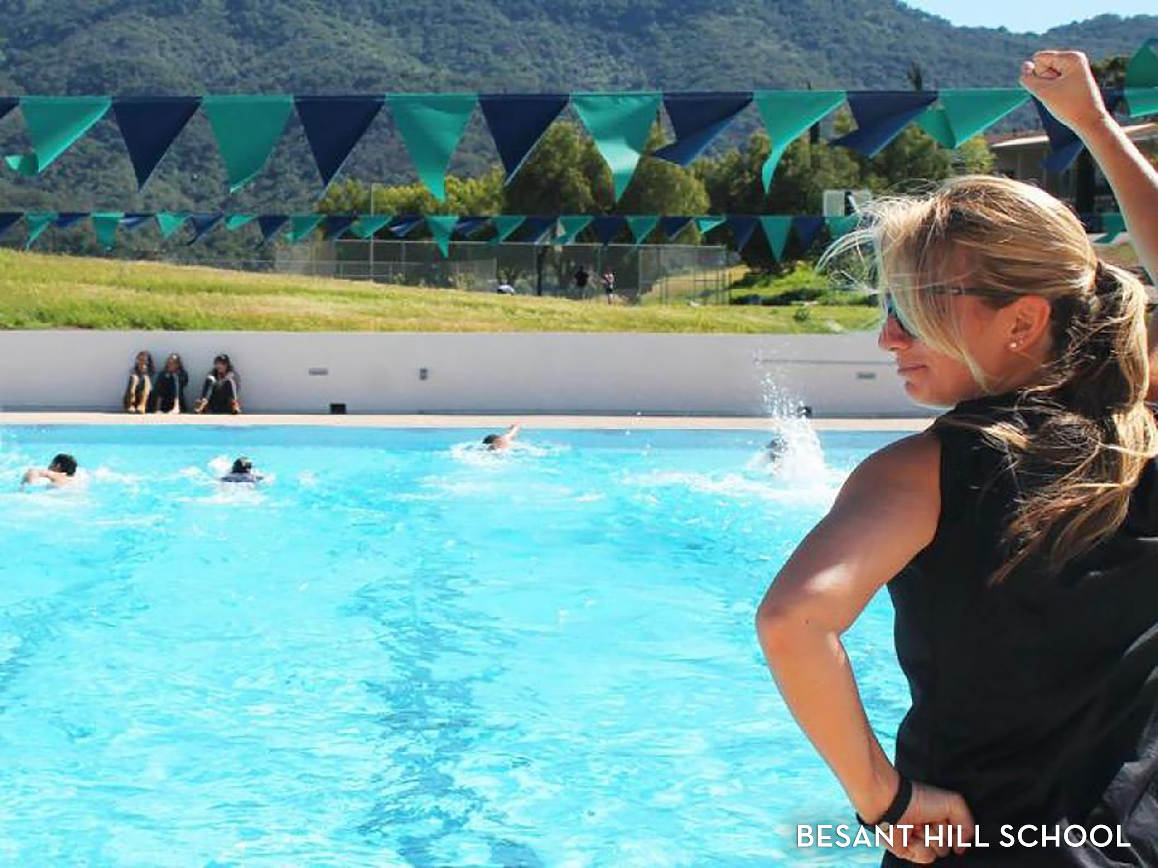

Slide 30
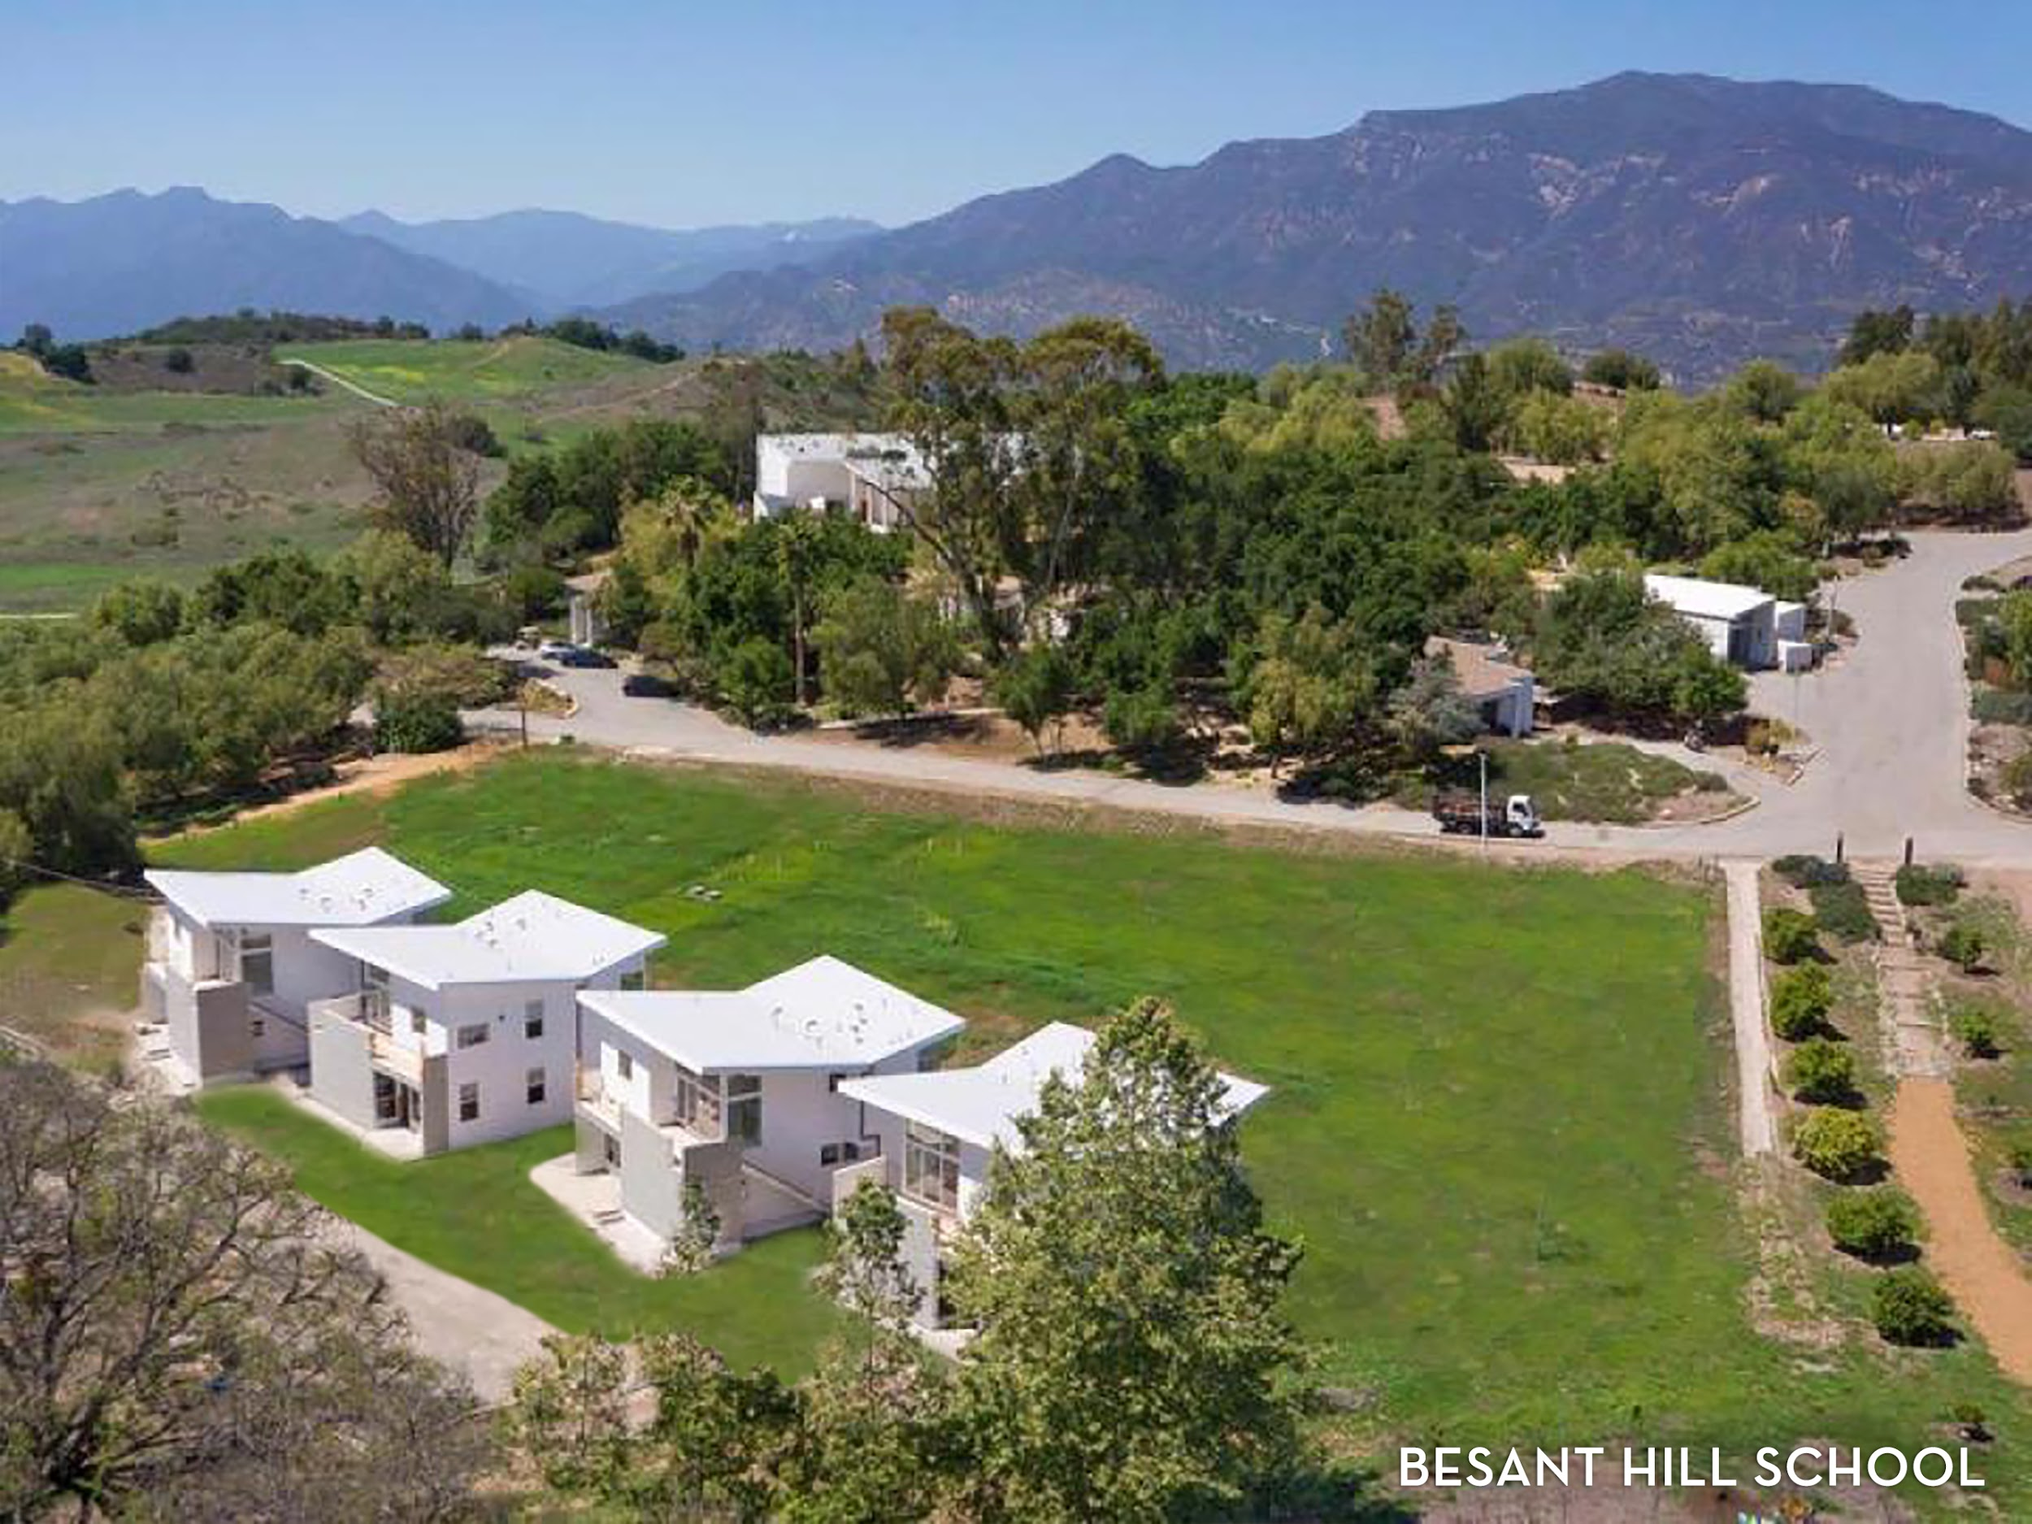

Slide 31


Slide 32
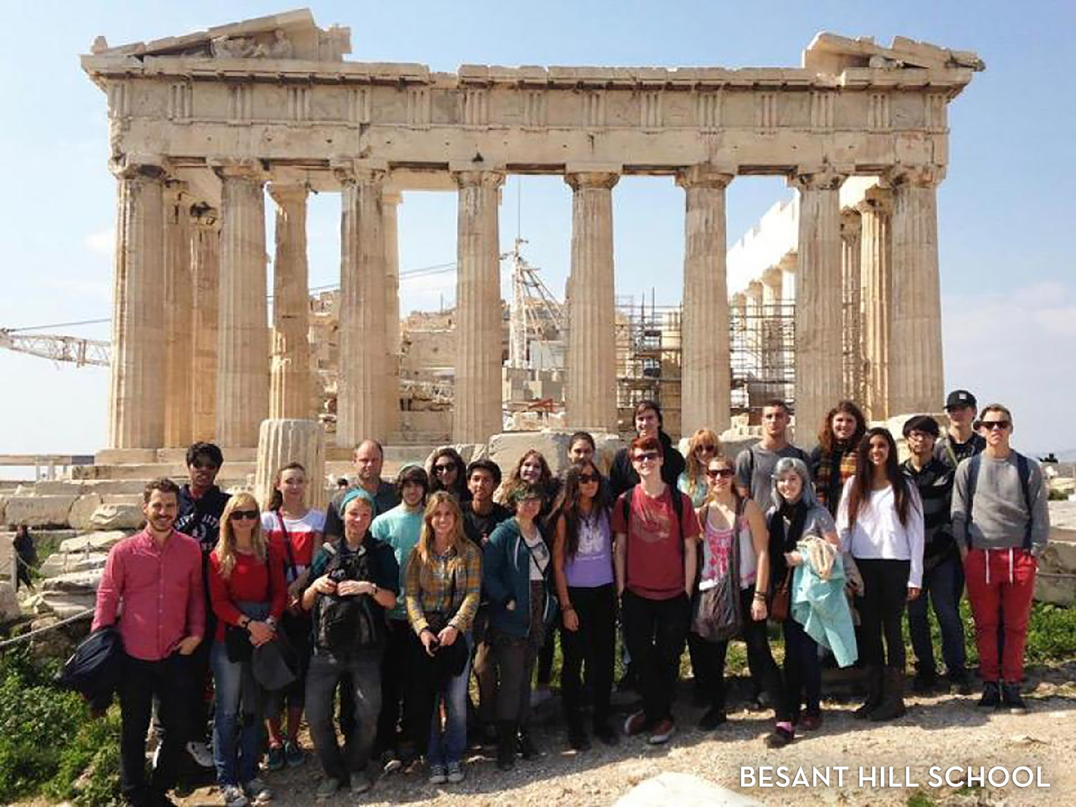

Slide 33
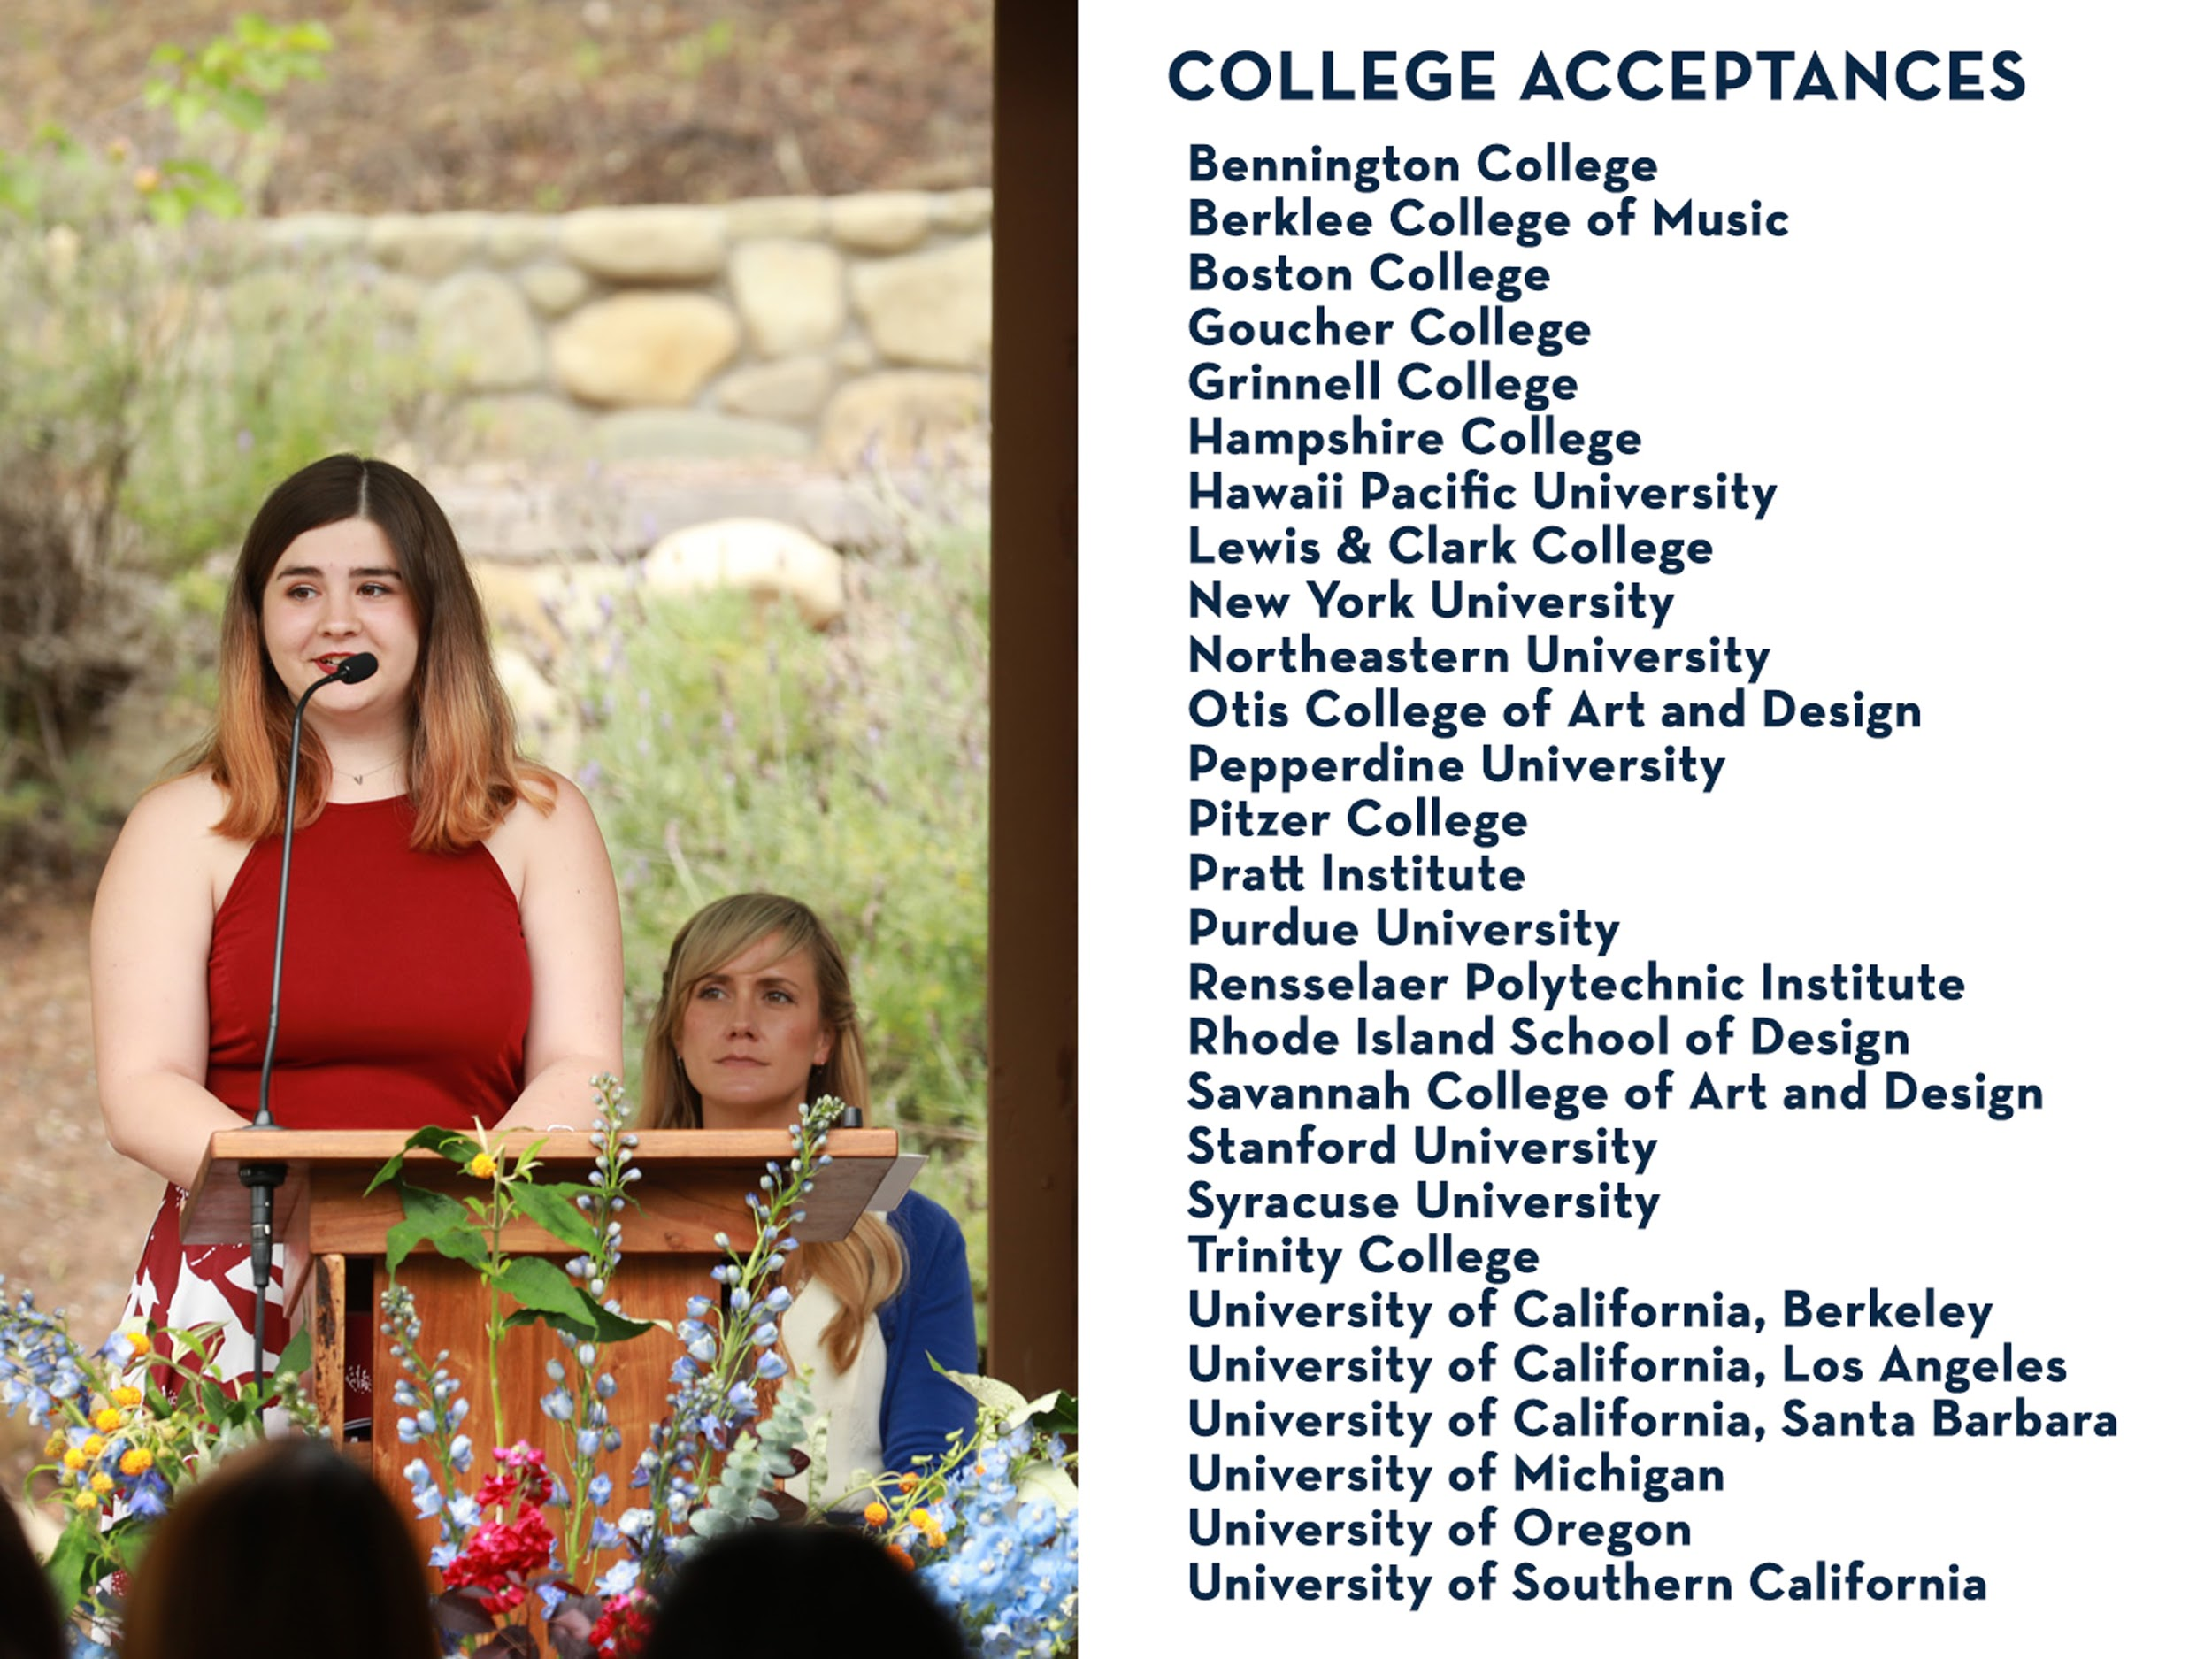

Slide 34


Slide 35
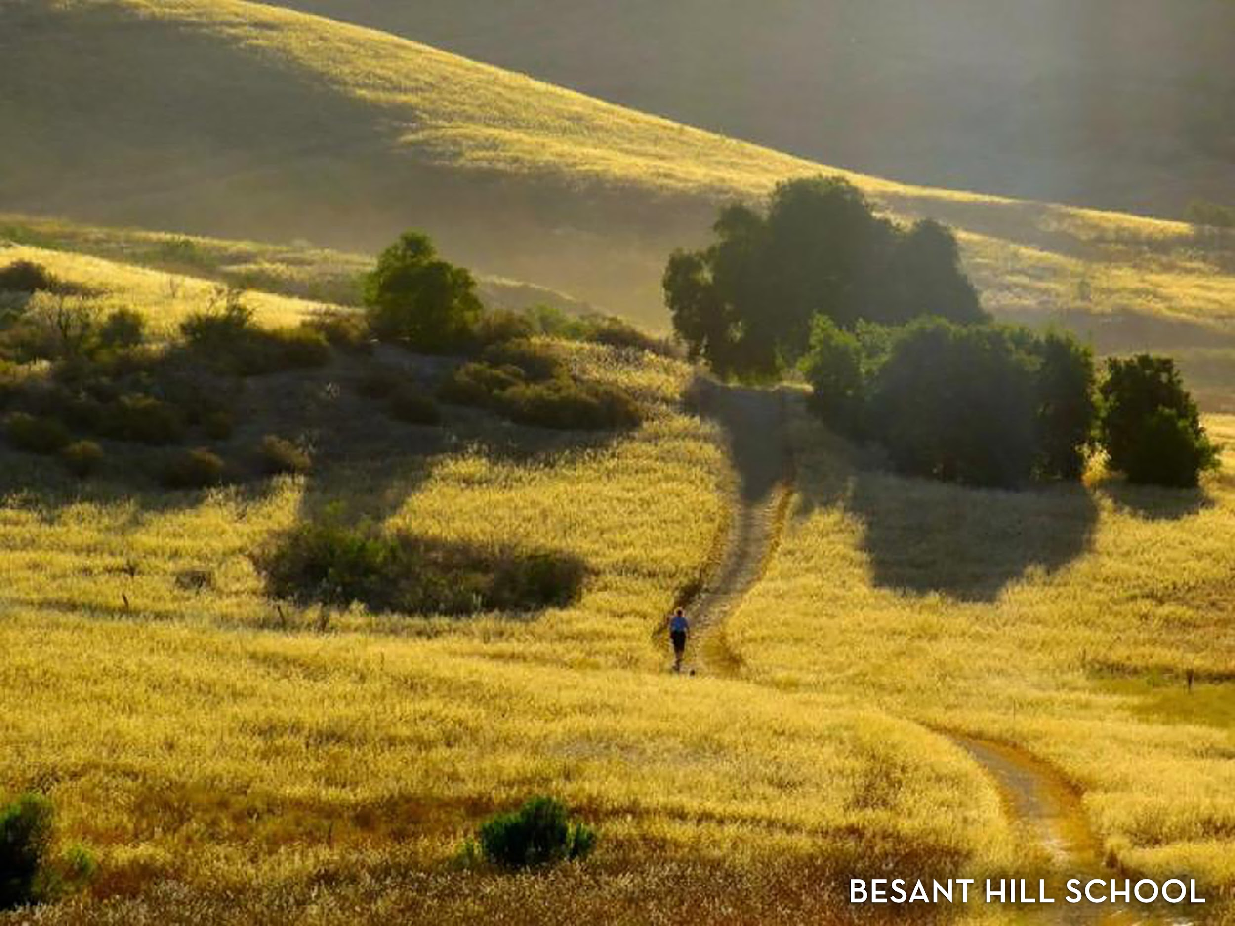

Slide 36
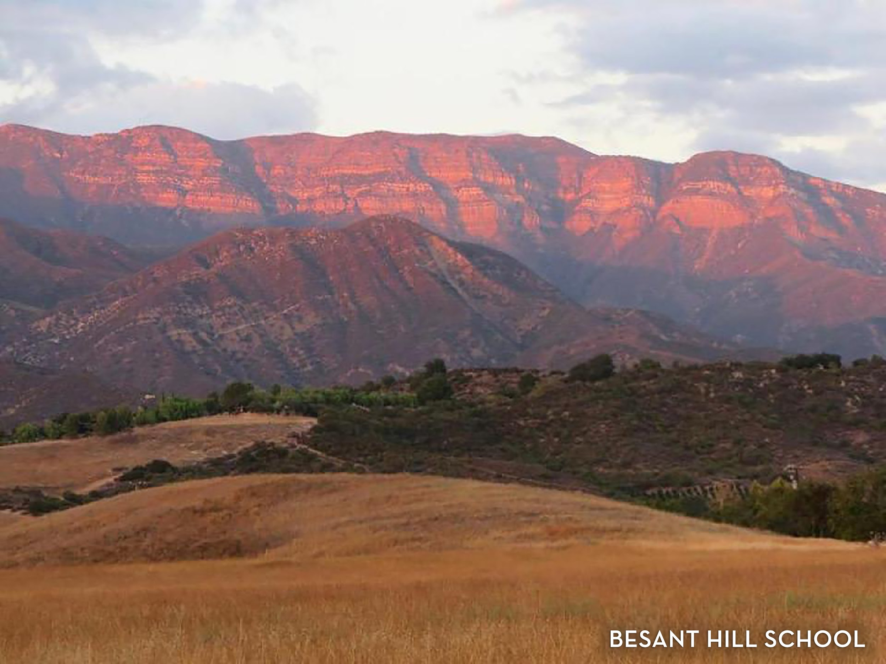

Slide 37
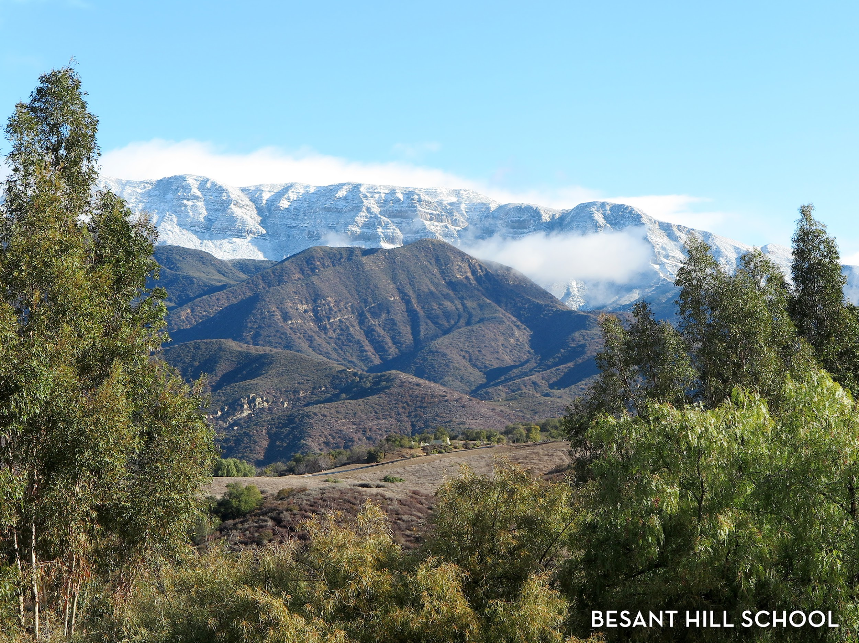

Slide 38
